Slide 1



Christmas Favourites

Slide 2

Christmas Favourites: Shared Example
Finding combinations
CHRISTMAS FAVOURITES
I SEE MATHS

Slide 3
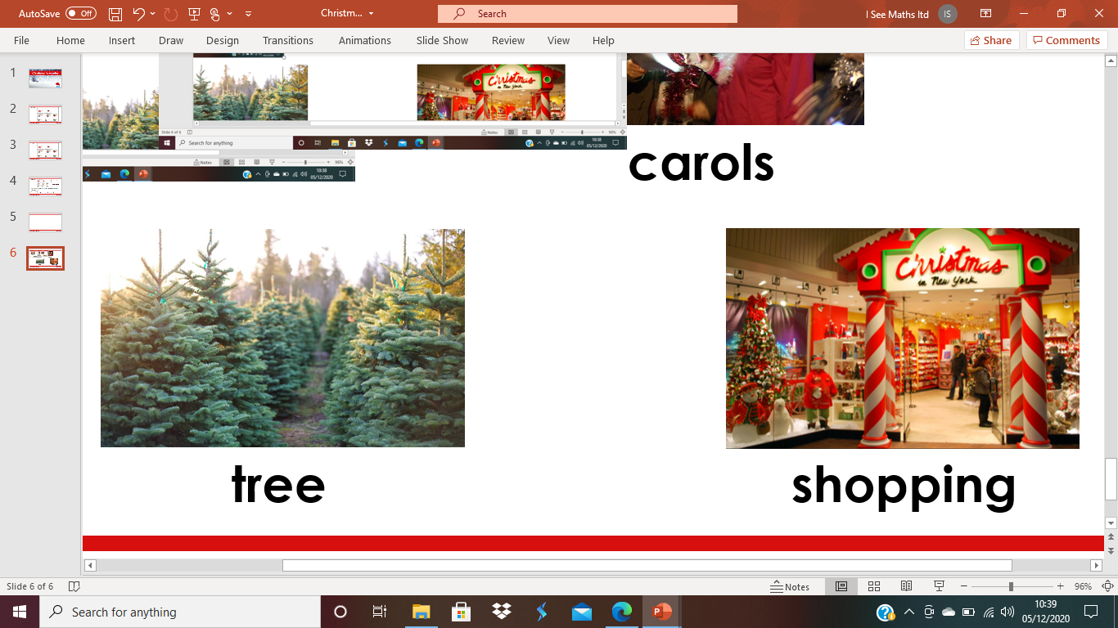
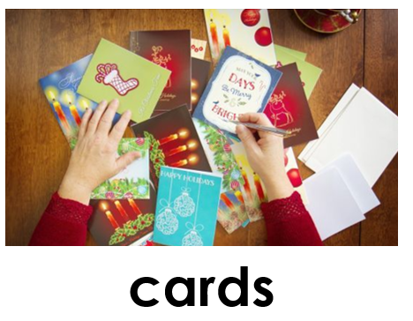
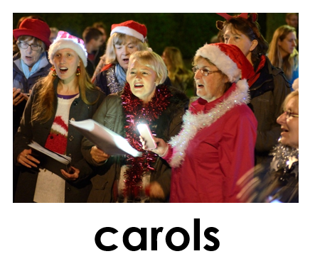
In what order can these Christmas jobs be done?
How many orders are there?
CHRISTMAS FAVOURITES
I SEE MATHS

Slide 4
In what order can these Christmas jobs be done?
How many orders are there?
Example answer: tree cards carols shopping
1st
2nd
3rd
4th
CHRISTMAS FAVOURITES
I SEE MATHS

Slide 5
In what order can these Christmas jobs be done?
How many orders are there?
Example answer: tree cards carols shopping
Estimate the total number of orders 10 orders 20 orders 30 orders
1st
2nd
3rd
4th
CHRISTMAS FAVOURITES
I SEE MATHS

Slide 6
Different answers, random order:
tree cards carols shopping
1st
2nd
3rd
4th
CHRISTMAS FAVOURITES
I SEE MATHS

Slide 7
Different answers, random order:
tree cards carols shopping
cards carols tree shopping
1st
2nd
3rd
4th
CHRISTMAS FAVOURITES
I SEE MATHS

Slide 8
Different answers, random order:
tree cards carols shopping
cards carols tree shopping
shopping cards tree carols
1st
2nd
3rd
4th
CHRISTMAS FAVOURITES
I SEE MATHS

Slide 9
Different answers, systematic order:
shopping cards tree carols
1st
2nd
3rd
4th
CHRISTMAS FAVOURITES
I SEE MATHS

Slide 10
Different answers, systematic order:
shopping cards tree carols
shopping cards carols tree
1st
2nd
3rd
4th
CHRISTMAS FAVOURITES
I SEE MATHS

Slide 11
Different answers, systematic order:
shopping cards tree carols
shopping cards carols tree
shopping tree cards carols
1st
2nd
3rd
4th
CHRISTMAS FAVOURITES
I SEE MATHS

Slide 12
Different answers, systematic order:
shopping cards tree carols
shopping cards carols tree
shopping tree cards carols
What do you expect to see next?
1st
2nd
3rd
4th
CHRISTMAS FAVOURITES
I SEE MATHS

Slide 13
Different answers, systematic order:
shopping cards tree carols
shopping cards carols tree
shopping tree cards carols
shopping tree carols cards
1st
2nd
3rd
4th
CHRISTMAS FAVOURITES
I SEE MATHS

Slide 14
Different answers, systematic order:
shopping cards tree carols
shopping cards carols tree
shopping tree cards carols
shopping tree carols cards
shopping carols cards tree
shopping carols tree cards
This is all the orders where shopping is first.
6 orders with shopping first.
How many possible orders?
CHRISTMAS FAVOURITES
I SEE MATHS

Slide 15
Different answers, systematic order:
shopping cards tree carols
shopping cards carols tree
shopping tree cards carols
shopping tree carols cards
shopping carols cards tree
shopping carols tree cards
This is all the orders where shopping is first.
6 orders with shopping first.
6 orders with cards first.
6 orders with tree first.
6 orders with carols first.
24 possible orders.
CHRISTMAS FAVOURITES
I SEE MATHS

Slide 16
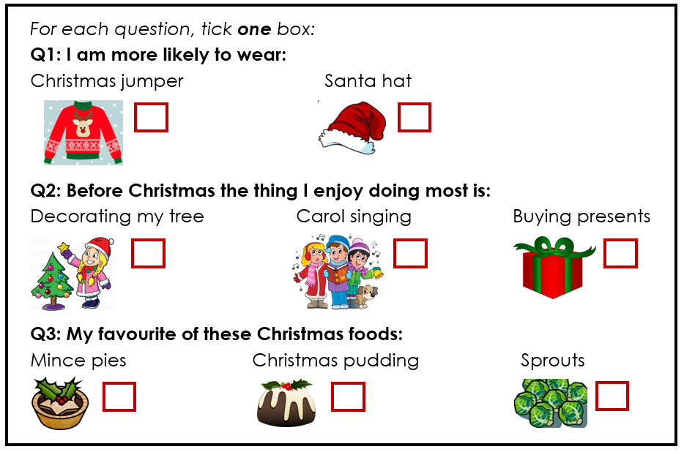
Children’s tasks on ‘Christmas Favourites Tasks’
Predict the most common response.
Complete the questionnaire.
Finding all the ways this questionnaire can be answered.
CHRISTMAS FAVOURITES
I SEE MATHS

