Slide 1
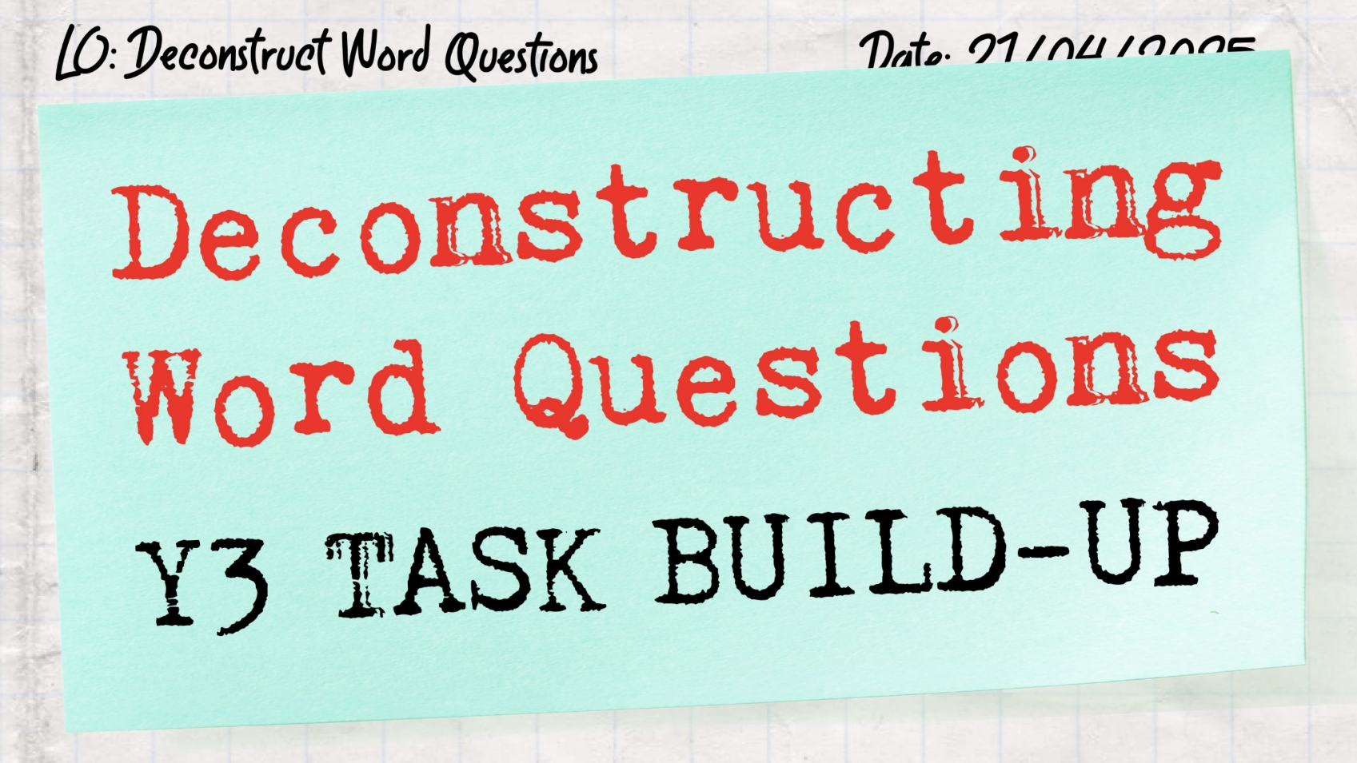

Slide 2

DECONSTRUCTING WORD QUESTIONS – Y3
TASK BUILD-UP
My Number
More Than, Less Than
The Whole, The Parts
Multi-Step Additive
Difference
Multiplication Contexts
Sharing and Grouping
Mixed Operations
Multi-Step
Fractions of a Quantity
Paying with Coins
Multi-Step Money
Time Calculation
Days and Months
Interpreting Graphs
Interpreting Tables

Slide 3
My Number
Build 1
My Number: Build 1
Find numbers in a section of a number line using clues

Slide 4
My Number
Build 1
0
100
200
300
400
The hidden numbers are…

Slide 5
My Number
Build 1
0
100
200
300
400

Slide 6
My Number
Build 1
My number is in this section.
0
100
200
300
400

Slide 7
My Number
Build 1
My number is in this section.
0
100
200
300
400
The tens value of my number is 7.
My number could be…

Slide 8
My Number
Build 1
My number is in this section.
0
100
200
300
400
The tens value of my number is 7.
Could my number be:
271 375 327

Slide 9

My Number
Build 1
My number is in this section.
0
100
200
300
400
271
327
375
The tens value of my number is 7.
Could my number be:
271 375 327

Slide 10
My Number
Build 1
0
50
100
150
200
The hidden number is…

Slide 11
My Number
Build 1
0
50
100
150
200

Slide 12
My Number
Build 1
My number is in this section.
0
50
100
150
200

Slide 13
My Number
Build 1
My number is in this section.
0
50
100
150
200
My number includes the digit 3.
My number could be…

Slide 14
My Number
Build 1
My number is in this section.
0
50
100
150
200
My number includes the digit 3.
Could my number be:
138 163

Slide 15
My Number
Build 1
My number is in this section.
0
50
100
150
200
138
163
My number includes the digit 3.
Could my number be:
138 163

Slide 16
My Number
Build 1
My Number
Next Step: Task A

Slide 17
My Number
Build 2
My Number: Build 2
Find different possible answers to a question and explain mistakes

Slide 18
My Number
Build 2
Is each number odd or even?
175
103
130

Slide 19
My Number
Build 2
Is each number odd or even?
175
odd
103
odd
130
even

Slide 20
My Number
Build 2
My number is in this section.
0
400
My number could be…

Slide 21
My Number
Build 2
My number is in this section.
0
400
Could it be…
231
234
273
287
321

Slide 22
My Number
Build 2
My number is in this section.
0
400
321
Could it be…
231
234
273
287
321

Slide 23
My Number
Build 2
My number is in this section.
0
400
My number includes the digit 3.
My number is odd.
Could it be…
231
234
273
287
321

Slide 24
My Number
Build 2
My number is in this section.
0
400
My number includes the digit 3.
My number is odd.
Could it be…
231
234
273
287
321

Slide 25
My Number
Build 2
My Number
Next Steps:
Task B Version 1 or Task B Version 2
Extend

Slide 26
More Than, Less Than
Build 1
More Than, Less Than: Build 1
Understand more than / less than word questions, using pictures

Slide 27
More Than, Less Than
Build 1
Jack has 7 conkers.
Jack has 3 more conkers than Kam.
How many conkers does Kam have?

Slide 28
More Than, Less Than
Build 1
Jack has 7 conkers.
Jack has 3 more conkers than Kam.
How many conkers does Kam have?
Represented with dots:
Jack
Kam
3

Slide 29
More Than, Less Than
Build 1
Jack has 7 conkers.
Jack has 3 more conkers than Kam.
How many conkers does Kam have?
Represented with dots:
Represented with a bar model:
Jack
Jack
7
Kam
3
Kam
3

Slide 30
More Than, Less Than
Build 1
Jack has 7 conkers.
Jack has 3 more conkers than Kam.
How many conkers does Kam have?
Represented with dots:
Represented with a bar model:
Jack
Jack
7
Kam
3
Kam
4
3
Answer: 4 conkers

Slide 31
More Than, Less Than
Build 1
Jen has 5 shells.
Amy has 3 shells fewer than Jen.
How many shells does Amy have?

Slide 32
More Than, Less Than
Build 1
Jen has 5 shells.
Amy has 3 shells fewer than Jen.
How many shells does Amy have?
Who has more shells?
Amy
Jen

Slide 33
More Than, Less Than
Build 1
Jen has 5 shells.
Amy has 3 shells fewer than Jen.
How many shells does Amy have?

Slide 34
More Than, Less Than
Build 1
Jen has 5 shells.
Amy has 3 shells fewer than Jen.
How many shells does Amy have?
Represented with dots:
Jen
Amy
3

Slide 35
More Than, Less Than
Build 1
Jen has 5 shells.
Amy has 3 shells fewer than Jen.
How many shells does Amy have?
Represented with dots:
Represented with a bar model:
Jen
Jen
5
Amy
3
Amy
3

Slide 36
More Than, Less Than
Build 1
Jen has 5 shells.
Amy has 3 shells fewer than Jen.
How many shells does Amy have?
Represented with dots:
Represented with a bar model:
Jen
Jen
5
Amy
3
Amy
2
3
Answer: 2 shells

Slide 37
More Than, Less Than
Build 1
Jen has 5 grapes.
Jen has 3 grapes fewer than Amy.
How many grapes does Amy have?

Slide 38
More Than, Less Than
Build 1
Jen has 5 grapes.
Jen has 3 grapes fewer than Amy.
How many grapes does Amy have?
Who has more grapes?
Amy
Jen

Slide 39
More Than, Less Than
Build 1
Jen has 5 grapes.
Jen has 3 grapes fewer than Amy.
How many grapes does Amy have?

Slide 40
More Than, Less Than
Build 1
Jen has 5 grapes.
Jen has 3 grapes fewer than Amy.
How many grapes does Amy have?
Represented with dots:
Jen
3
Amy

Slide 41
More Than, Less Than
Build 1
Jen has 5 grapes.
Jen has 3 grapes fewer than Amy.
How many grapes does Amy have?
Represented with dots:
Represented with a bar model:
Jen
Jen
3
3
5
Amy
Amy

Slide 42
More Than, Less Than
Build 1
Jen has 5 grapes.
Jen has 3 grapes fewer than Amy.
How many grapes does Amy have?
Represented with dots:
Represented with a bar model:
Jen
Jen
3
3
5
Amy
Amy
8
Answer: 8 grapes

Slide 43
More Than, Less Than
Build 1
More Than, Less Than
Next Step: Task A

Slide 44
More Than, Less Than
Build 2
My Number: Build 2
Understand 2-step more than / less than word questions, using pictures

Slide 45
More Than, Less Than
Build 2
Kim has 4 crayons.
Eve has 2 more crayons than Kim.
How many crayons do they have altogether?

Slide 46
More Than, Less Than
Build 2
Kim has 4 crayons.
Eve has 2 more crayons than Kim.
How many crayons do they have altogether?
Kim

Slide 47
More Than, Less Than
Build 2
Kim has 4 crayons.
Eve has 2 more crayons than Kim.
How many crayons do they have altogether?
Kim
2
Eve

Slide 48
More Than, Less Than
Build 2
Kim has 4 crayons.
Eve has 2 more crayons than Kim.
How many crayons do they have altogether?
Kim
2
Answer: 10 crayons
Eve

Slide 49
More Than, Less Than
Build 2
Ben has 7 stickers.
Ben has 3 fewer stickers than Tim.
How many stickers do Ben and Tim have altogether?

Slide 50
More Than, Less Than
Build 2
Ben has 7 stickers.
Ben has 3 fewer stickers than Tim.
How many stickers do Ben and Tim have altogether?
Which bar model?
7
7
3
Ben
Ben
Tim
?
Tim
?
3

Slide 51
More Than, Less Than
Build 2
Ben has 7 stickers.
Ben has 3 fewer stickers than Tim.
How many stickers do Ben and Tim have altogether?
7
3
Ben
Tim
?

Slide 52
More Than, Less Than
Build 2
Ben has 7 stickers.
Ben has 3 fewer stickers than Tim.
How many stickers do Ben and Tim have altogether?
Which Answer?
10
7
3
Ben
17
Tim
10

Slide 53
More Than, Less Than
Build 2
More Than, Less Than
Next Steps:
Task B Version 1 or Task B Version 2
Extend

Slide 54
The Whole, The Parts
Build 1
The Whole, The Parts: Build 1
Identify the whole and the parts in a question

Slide 55
The Whole, The Parts
Build 1
There are 9 people upstairs.
There are 4 people downstairs.
How many people in the house?

Slide 56
The Whole, The Parts
Build 1
There are 9 people upstairs.
There are 4 people downstairs.
How many people in the house?
?
9 | 4
calculate the value of the whole

Slide 57
The Whole, The Parts
Build 1
There are 9 people upstairs.
There are 4 people downstairs.
How many people in the house?
There are 14 people at the café.
6 people are sat indoors.
How many people are sat outdoors?
?
9 | 4
calculate the value of the whole

Slide 58
The Whole, The Parts
Build 1
There are 9 people upstairs.
There are 4 people downstairs.
How many people in the house?
There are 14 people at the café.
6 people are sat indoors.
How many people are sat outdoors?
?
14
9 | 4
6 | ?
calculate the value of the whole
calculate the value of a part

Slide 59
The Whole, The Parts
Build 1
Mr Jones took 40 cartons of juice on the school trip. They were either apple juice or orange juice.
There were 26 cartons of apple juice.
How many cartons of orange juice were there?

Slide 60
The Whole, The Parts
Build 1
Mr Jones took 40 cartons of juice on the school trip. They were either apple juice or orange juice.
There were 26 cartons of apple juice.
How many cartons of orange juice were there?
40
?
OR
26 | ?
40 | 26

Slide 61
The Whole, The Parts
Build 1
There are 50 adults on the train.
There are 30 children on the train.
How many people are there on the train?

Slide 62
The Whole, The Parts
Build 1
There are 50 adults on the train.
There are 30 children on the train.
How many people are there on the train?
50
?
OR
30 | ?
50 | 30

Slide 63
The Whole, The Parts
Build 1
There are 123 children at Marton Primary School.
82 of the children are inside.
How many children are outside?

Slide 64
The Whole, The Parts
Build 1
There are 123 children at Marton Primary School.
82 of the children are inside.
How many children are outside?
123
?
OR
82 | ?
123 | 82

Slide 65
The Whole, The Parts
Build 1
The Whole, The Parts
Next Step: Task A

Slide 66
The Whole, The Parts
Build 2
The Whole, The Parts: Build 2
Identify the whole and the parts before the numbers can be seen

Slide 67
The Whole, The Parts
Build 2
There are some coins on the table.
12 are showing heads.
15 are showing tails.
How many coins are there on the table?
The question asks for the whole
The question asks for a part
OR

Slide 68
The Whole, The Parts
Build 2
There are some coins on the table.
12 are showing heads.
15 are showing tails.
How many coins are there on the table?
The question asks for the whole

Slide 69
The Whole, The Parts
Build 2
There are some coins on the table.
12 are showing heads.
15 are showing tails.
How many coins are there on the table?
?
The question asks for the whole
12 | 15

Slide 70
The Whole, The Parts
Build 2
There are some coins on the table.
12 are showing heads.
15 are showing tails.
How many coins are there on the table?
27
The question asks for the whole
12 | 15
Answer: 27 coins

Slide 71
The Whole, The Parts
Build 2
A box of sweets weighs 800g.
The box weighs 200g.
What is the weight of the sweets?
The question asks for the whole
The question asks for a part
OR

Slide 72
The Whole, The Parts
Build 2
A box of sweets weighs 800g.
The box weighs 200g.
What is the weight of the sweets?
The question asks for a part

Slide 73
The Whole, The Parts
Build 2
A box of sweets weighs 800g.
The box weighs 200g.
What is the weight of the sweets?
800g
200g | ?
The question asks for a part

Slide 74
The Whole, The Parts
Build 2
A box of sweets weighs 800g.
The box weighs 200g.
What is the weight of the sweets?
800g
200g | 600g
The question asks for a part
Answer: 600g

Slide 75
The Whole, The Parts
Build 2
The Whole, The Parts
Next Steps:
Task B Version 1 or Task B Version 2
Extend

Slide 76
Multi-Step Additive
Build 1
Multi-Step Additive: Build 1
Understand different types of addition and subtraction questions, using pictures

Slide 77
Multi-Step Additive
Build 1
40 people were travelling to London on the bus.
26 people were travelling to London on the train.
How many people were travelling to London in total?
Bar Model:
What could the hidden information be?
?
40 | 26

Slide 78
Multi-Step Additive
Build 1
40 people were travelling to London on the bus.
26 people were travelling to London on the train.
How many people were travelling to London in total?
Bar Model:
?
40 | 26

Slide 79
Multi-Step Additive
Build 1
40 people were travelling to London on the bus.
26 people were travelling to London on the train.
How many people were travelling to London in total?
Bar Model:
66
Answer: 66 people
40 | 26

Slide 80
Multi-Step Additive
Build 1
40 people were on the bus for the school trip.
On the bus, there were 12 adults and some children.
How many children were on the bus?
Bar Model:
What could the hidden information be?
40
12 | ?

Slide 81
Multi-Step Additive
Build 1
40 people were on the bus for the school trip.
On the bus, there were 12 adults and some children.
How many children were on the bus?
Bar Model:
40
12 | ?

Slide 82
Multi-Step Additive
Build 1
40 people were on the bus for the school trip.
On the bus, there were 12 adults and some children.
How many children were on the bus?
Bar Model:
40
Answer: 28 children
12 | 28

Slide 83
Multi-Step Additive
Build 1
40 people were travelling on the bus.
At the next stop, 8 people got on the bus and 5 people got off.
How many people are on the bus now?
Bar Model:
What could the hidden information be?
40 | 8
5
?

Slide 84
Multi-Step Additive
Build 1
40 people were travelling on the bus.
At the next stop, 8 people got on the bus and 5 people got off.
How many people are on the bus now?
Bar Model:
40 | 8
5
?

Slide 85
Multi-Step Additive
Build 1
40 people were travelling on the bus.
At the next stop, 8 people got on the bus and 5 people got off.
How many people are on the bus now?
Bar Model:
40 | 8
Answer: 43 people
5
43

Slide 86
Multi-Step Additive
Build 1
Multi-Step Additive
Next Step: Task A

Slide 87
Multi-Step Additive
Build 2
Multi-Step Additive: Build 2
Understand different types of addition and subtraction questions, using pictures

Slide 88
Multi-Step Additive
Build 2
There are 30 children in Owl class.
16 of the children walked to school. 11 children came by car. The rest of the children cycled.
How many children in Owl class cycled to school?

Slide 89
Multi-Step Additive
Build 2
There are 30 children in Owl class.
16 of the children walked to school. 11 children came by car. The rest of the children cycled.
How many children in Owl class cycled to school?
Which bar model?
?
30
30 | 16 | 11
16 | 11 | ?

Slide 90
Multi-Step Additive
Build 2
There are 30 children in Owl class.
16 of the children walked to school. 11 children came by car. The rest of the children cycled.
How many children in Owl class cycled to school?
30
Answer: 3 children
16 | 11 | 3

Slide 91
Multi-Step Additive
Build 2
Last term, 25 children went to the school choir.
Then, 7 children left the choir, and 3 new children joined the choir.
How many children in the school choir now?

Slide 92
Multi-Step Additive
Build 2
Last term, 25 children went to the school choir.
Then, 7 children left the choir, and 3 new children joined the choir.
How many children in the school choir now?
Which bar model?
25 | 7
25 | 3
3
7
?
?

Slide 93
Multi-Step Additive
Build 2
Last term, 25 children went to the school choir.
Then, 7 children left the choir, and 3 new children joined the choir.
How many children in the school choir now?
25 | 3
Answer: 21 children
7
21

Slide 94
Multi-Step Additive
Build 2
Multi-Step Additive
Next Steps:
Task B Version 1 or Task B Version 2
Extend

Slide 95
Difference
Build 1
Difference: Build 1
Understand ‘more’ and ‘how many more’ questions

Slide 96
Difference
Build 1
This is an addition question that includes the word more:
Jen had 10 books.
Then, she bought 3 more books.
How many books does Jen have now?
Answer: 13 books
What could the hidden information be?

Slide 97
Difference
Build 1
This is an addition question that includes the word more:
Jen had 10 books.
Then, she bought 3 more books.
How many books does Jen have now?
Answer: 13 books

Slide 98
Difference
Build 1
This is an addition question that includes the word more:
Jen had 10 books.
Then, she bought 3 more books.
How many books does Jen have now?
Answer: 13 books
13
10 | 3

Slide 99
Difference
Build 1
This is a subtraction question that includes the word more:
Amy has 10 stickers.
Kate has 7 stickers.
How many more stickers does Amy have than Kate?
Answer: 3 stickers
What could the hidden question be?

Slide 100
Difference
Build 1
This is a subtraction question that includes the word more:
Amy has 10 stickers.
Kate has 7 stickers.
How many more stickers does Amy have than Kate?
Answer: 3 stickers

Slide 101
Difference
Build 1
This is a subtraction question that includes the word more:
Amy has 10 stickers.
Kate has 7 stickers.
How many more stickers does Amy have than Kate?
Answer: 3 stickers
Subtract to calculate the difference
10
7
3

Slide 102
Difference
Build 1
This is an addition question that includes the word more:
Jen had 10 books.
Then, she bought 3 more books.
How many books does Jen have now?
Answer: 13 books
This is a subtraction question that includes the word more:
Amy has 10 stickers.
Kate has 7 stickers.
How many more stickers does Amy have than Kate?
Answer: 3 stickers
13
10
10 | 3
7
3

Slide 103
Difference
Build 1
25
There are children in Owl class.
of the children in Owl class are inside.
of the children in Owl class are outside.
There are 5 more children inside than outside.
15
10
What could the missing numbers be?
There are different possible answers.

Slide 104
Difference
Build 1
25
There are children in Owl class.
of the children in Owl class are inside.
of the children in Owl class are outside.
There are 5 more children inside than outside.
15
10
Example answer 1:
In
15
Out
10
5

Slide 105
Difference
Build 1
27
There are children in Owl class.
of the children in Owl class are inside.
of the children in Owl class are outside.
There are 5 more children inside than outside.
16
11
Example answer 2:
In
16
Out
11
5

Slide 106
Difference
Build 1
Difference
Next Step: Task A

Slide 107
Difference
Build 2
Difference: Build 2
Understand multi-step difference questions

Slide 108
Difference
Build 2
Ben had 9 grapes.
Jack had 3 grapes.
Then, Ben ate 4 grapes.
How many more grapes does Ben have than Jack?
What information could be here?

Slide 109
Difference
Build 2
Ben had 9 grapes.
Jack had 3 grapes.
Then, Ben ate 4 grapes.
How many more grapes does Ben have than Jack?
Answer: 2 grapes
What information could be here?

Slide 110
Difference
Build 2
Ben had 9 grapes.
Jack had 3 grapes.
Then, Ben ate 4 grapes.
How many more grapes does Ben have than Jack?
Answer: 2 grapes
Answer 1

Slide 111
Difference
Build 2
Ben had 9 grapes.
Jack had 3 grapes.
Then, Ben ate 4 grapes.
How many more grapes does Ben have than Jack?
Answer: 2 grapes
Answer 1
Ben
Jack

Slide 112
Difference
Build 2
Ben had 9 grapes.
Jack had 3 grapes.
Then, Ben ate 4 grapes.
How many more grapes does Ben have than Jack?
Answer: 2 grapes
Answer 1
Ben
Jack

Slide 113
Difference
Build 2
Ben had 9 grapes.
Jack had 3 grapes.
Then, Ben gave Jack 2 grapes.
How many more grapes does Ben have than Jack?
Answer: 2 grapes
Answer 2

Slide 114
Difference
Build 2
Ben had 9 grapes.
Jack had 3 grapes.
Then, Ben gave Jack 2 grapes.
How many more grapes does Ben have than Jack?
Answer: 2 grapes
Answer 2
Ben
Jack

Slide 115
Difference
Build 2
Ben had 9 grapes.
Jack had 3 grapes.
Then, Ben gave Jack 2 grapes.
How many more grapes does Ben have than Jack?
Answer: 2 grapes
Answer 2
Ben
Jack

Slide 116
Difference
Build 2
Ben had 9 grapes.
Jack had 3 grapes.
Then, Ben gave Jack 2 grapes.
How many more grapes does Ben have than Jack?
Answer: 2 grapes
Answer 2
Ben
Jack

Slide 117
Difference
Build 2
Difference
Next Steps:
Task B Version 1 or Task B Version 2
Extend

Slide 118
Multiplication Contexts
Build 1
Multiplication Contexts: Build 1
Identify whether a question involves multiplication, using pictures

Slide 119
Multiplication Contexts
Build 1
Ben is 5 years old.
Tom is 3 years older than Ben.
How old is Tom?

Slide 120
Multiplication Contexts
Build 1
Ben is 5 years old.
Tom is 3 years older than Ben.
How old is Tom?
Which Picture?
Ben
5 years
Ben
5 years
Tom
8 years
Tom
5 years | 5 years | 5 years
Tom is 8
Tom is 15

Slide 121
Multiplication Contexts
Build 1
Ben is 5 years old.
Tom is 3 years older than Ben.
How old is Tom?
Ben
5 years
Tom
8 years
Tom is 8

Slide 122
Multiplication Contexts
Build 1
Beth is 5 years old.
Rose is 3 times as old as Beth.
How old is Rose?

Slide 123
Multiplication Contexts
Build 1
Beth is 5 years old.
Rose is 3 times as old as Beth.
How old is Rose?
Which Picture?
Beth
5 years
Beth
5 years
Rose
8 years
Rose
5 years | 5 years | 5 years
Rose is 8
Rose is 15

Slide 124
Multiplication Contexts
Build 1
Beth is 5 years old.
Rose is 3 times as old as Beth.
How old is Rose?
Beth
5 years
Rose
5 years | 5 years | 5 years
Rose is 15

Slide 125
Multiplication Contexts
Build 1
3 rows of chairs have been put out in the school hall.
There are 10 chairs in each row.
How many chairs are out in the school hall?

Slide 126
Multiplication Contexts
Build 1
3 rows of chairs have been put out in the school hall.
There are 10 chairs in each row.
How many chairs are out in the school hall?
Which Picture?
13 chairs
30 chairs

Slide 127
Multiplication Contexts
Build 1
3 rows of chairs have been put out in the school hall.
There are 10 chairs in each row.
How many chairs are out in the school hall?
30 chairs

Slide 128
Multiplication Contexts
Build 1
For lunch, you can have pizza or pasta or a burger.
Then, you can have a cake or an apple.
How many different meals can be chosen?

Slide 129





Multiplication Contexts
Build 1
For lunch, you can have pizza or pasta or a burger.
Then, you can have a cake or an apple.
How many different meals can be chosen?
Which Picture?
5 meals
6 meals
+

Slide 130
Multiplication Contexts
Build 1
For lunch, you can have pizza or pasta or a burger.
Then, you can have a cake or an apple.
How many different meals can be chosen?
6 meals

Slide 131
Multiplication Contexts
Build 1
For lunch, you can have pizza or pasta or a burger.
Then, you can have a cake or an apple.
How many different meals can be chosen?
6 meals
Another representation:
pizza pasta burger
cake apple

Slide 132
Multiplication Contexts
Build 1
For lunch, you can have pizza or pasta or a burger.
Then, you can have a cake or an apple.
How many different meals can be chosen?
6 meals
Another representation:
pizza pasta burger
cake apple

Slide 133
Multiplication Contexts
Build 1
For lunch, you can have pizza or pasta or a burger.
Then, you can have a cake or an apple.
How many different meals can be chosen?
6 meals
Another representation:
pizza pasta burger
cake apple

Slide 134
Multiplication Contexts
Build 1
For lunch, you can have pizza or pasta or a burger.
Then, you can have a cake or an apple.
How many different meals can be chosen?
6 meals
Another representation:
pizza pasta burger
cake apple

Slide 135
Multiplication Contexts
Build 1
Multiplication Contexts
Next Step: Task A

Slide 136
Multiplication Contexts
Build 2
Multiplication Contexts: Build 2
Identify the information that is / is not needed to answer the question

Slide 137
Multiplication Contexts
Build 2
Kim has 2 pens.
Kim has 3 packs of pencils.
There are 4 pencils in each pack.
How many pencils does Kim have?
Which pieces of information are needed to answer the question?

Slide 138
Multiplication Contexts
Build 2
Kim has 2 pens.
Kim has 3 packs of pencils.
There are 4 pencils in each pack.
How many pencils does Kim have?
Which pieces of information are needed to answer the question?

Slide 139
Multiplication Contexts
Build 2
Kim has 2 pens.
Kim has 3 packs of pencils.
There are 4 pencils in each pack.
How many pencils does Kim have?

Slide 140
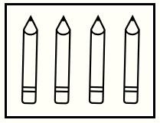
Multiplication Contexts
Build 2
Kim has 2 pens.
Kim has 3 packs of pencils.
There are 4 pencils in each pack.
How many pencils does Kim have?

Slide 141
Multiplication Contexts
Build 2
Kim has 2 pens.
Kim has 3 packs of pencils.
There are 4 pencils in each pack.
How many pencils does Kim have?
Answer: 12 pencils

Slide 142
Multiplication Contexts
Build 2
Jack had 6 golf balls.
Then, he buys 2 packs of golf balls.
There are 3 golf balls in each pack.
How many golf balls does Jack have now?
Which pieces of information are needed to answer the question?

Slide 143
Multiplication Contexts
Build 2
Jack had 6 golf balls.
Then, he buys 2 packs of golf balls.
There are 3 golf balls in each pack.
How many golf balls does Jack have now?
Which pieces of information are needed to answer the question?

Slide 144
Multiplication Contexts
Build 2
Jack had 6 golf balls.
Then, he buys 2 packs of golf balls.
There are 3 golf balls in each pack.
How many golf balls does Jack have now?

Slide 145
Multiplication Contexts
Build 2
Jack had 6 golf balls.
Then, he buys 2 packs of golf balls.
There are 3 golf balls in each pack.
How many golf balls does Jack have now?
+

Slide 146
Multiplication Contexts
Build 2
Jack had 6 golf balls.
Then, he buys 2 packs of golf balls.
There are 3 golf balls in each pack.
How many golf balls does Jack have now?
+
Answer: 12 golf balls

Slide 147
Multiplication Contexts
Build 2
Multiplication Contexts
Next Steps:
Task B Version 1 or Task B Version 2
Extend

Slide 148
Sharing and Grouping
Build 1
Sharing and Grouping: Build 1
Identify if a question involves sharing or grouping, using pictures

Slide 149
Sharing and Grouping
Build 1
There are 15 people doing a quiz.
The people are put into teams of 3 people.
How many teams are there in the quiz?

Slide 150
Sharing and Grouping
Build 1
There are 15 people doing a quiz.
The people are put into teams of 3 people.
How many teams are there in the quiz?
3
3
3
3
3
Which picture?
The number of groups
The number in each group
We call this grouping
We call this sharing

Slide 151
Sharing and Grouping
Build 1
There are 15 people doing a quiz.
The people are put into teams of 3 people.
How many teams are there in the quiz?
3
3
3
3
3
The number of groups
We call this grouping

Slide 152
Sharing and Grouping
Build 1
There are 15 people doing a quiz.
The people are put into teams of 3 people.
How many teams are there in the quiz?
3
3
3
3
3
The number of groups
We call this grouping

Slide 153
Sharing and Grouping
Build 1
There are 15 people doing a quiz.
The people are put into teams of 3 people.
How many teams are there in the quiz?
3
3
3
3
3
Answer: 5 teams
The number of groups
We call this grouping

Slide 154
Sharing and Grouping
Build 1
There are 15 children at football club.
The children are put into 3 teams.
How many children are there in each team?

Slide 155
Sharing and Grouping
Build 1
There are 15 children at football club.
The children are put into 3 teams.
How many children are there in each team?
3
3
3
3
3
Which picture?
The number of groups
The number in each group
We call this grouping
We call this sharing

Slide 156
Sharing and Grouping
Build 1
There are 15 children at football club.
The children are put into 3 teams.
How many children are there in each team?
The number in each group
We call this sharing

Slide 157
Sharing and Grouping
Build 1
There are 15 children at football club.
The children are put into 3 teams.
How many children are there in each team?
The number in each group
We call this sharing

Slide 158
Sharing and Grouping
Build 1
There are 15 children at football club.
The children are put into 3 teams.
How many children are there in each team?
5
5
5
Answer: 5 children
The number in each group
We call this sharing

Slide 159
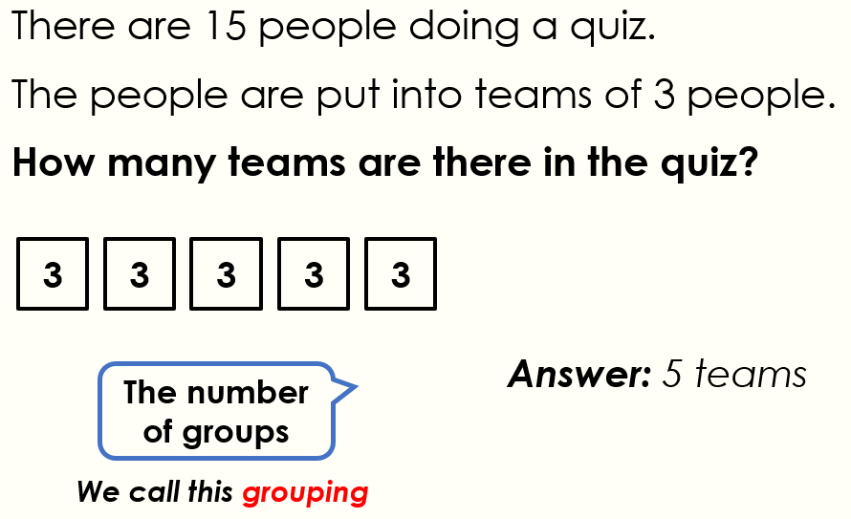
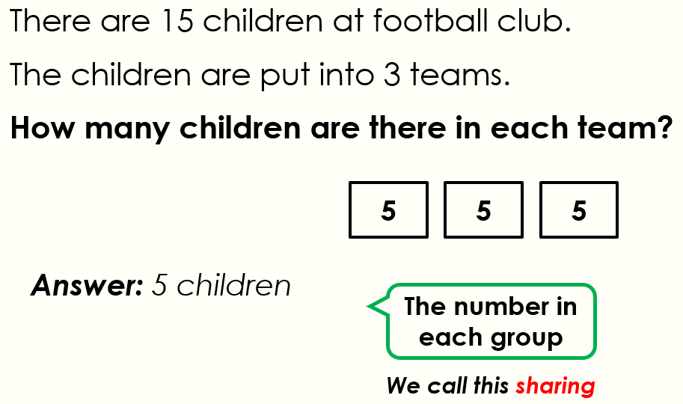
Sharing and Grouping
Build 1
What’s the same?
What’s different?

Slide 160
Sharing and Grouping
Build 1
Sharing and Grouping
Next Step: Task A

Slide 161
Sharing and Grouping
Build 2
Sharing and Grouping: Build 2
Compare sharing and grouping questions

Slide 162
Sharing and Grouping
Here are two 18 ÷ 3 questions
Build 2
There are 18 seeds.
Jen puts them equally into 3 pots.
How many seeds in each pot?
There are 18 seeds.
Zara puts 3 seeds in each pot.
How many pots does she use?

Slide 163
Sharing and Grouping
Here are two 18 ÷ 3 questions
Build 2
There are 18 seeds.
Jen puts them equally into 3 pots.
How many seeds in each pot?
There are 18 seeds.
Zara puts 3 seeds in each pot.
How many pots does she use?
3
sharing
grouping

Slide 164
Sharing and Grouping
Here are two 18 ÷ 3 questions
Build 2
There are 18 seeds.
Jen puts them equally into 3 pots.
How many seeds in each pot?
There are 18 seeds.
Zara puts 3 seeds in each pot.
How many pots does she use?
6
6
6
3
3
3
3
3
3
sharing
grouping
How does each picture show the answer?

Slide 165
Sharing and Grouping
Here are two 16 ÷ 8 questions
Build 2
There are 16 pencils.
They are shared equally between 8 children.
How many pencils does each child get?
There are 16 pencils.
8 pencils are put in each pencil case.
How many pencils cases are used?

Slide 166
Sharing and Grouping
Here are two 16 ÷ 8 questions
Build 2
There are 16 pencils.
They are shared equally between 8 children.
How many pencils does each child get?
There are 16 pencils.
8 pencils are put in each pencil case.
How many pencils cases are used?
8
sharing
grouping

Slide 167
Sharing and Grouping
Here are two 16 ÷ 8 questions
Build 2
There are 16 pencils.
They are shared equally between 8 children.
How many pencils does each child get?
There are 16 pencils.
8 pencils are put in each pencil case.
How many pencils cases are used?
2
2
2
2
2
2
2
2
8
8
sharing
grouping
How does each picture show the answer?

Slide 168
Sharing and Grouping
Build 2
Sharing and Grouping
Next Steps:
Task B Version 1 or Task B Version 2
Extend

Slide 169
Mixed Operations
Build 1
Mixed Operations: Build 1
Understand different word questions by making predictions and using pictures

Slide 170
Mixed Operations
Build 1
Zara buys 3 pencils.
Each pencil costs 60p.
How much does it cost?
How many pencils can Zara afford?
How much does it cost?
What is the question? How do you know?

Slide 171
Mixed Operations
Build 1
Zara buys 3 pencils.
Each pencil costs 60p.
How much does it cost?

Slide 172
Mixed Operations
Build 1
Zara buys 3 pencils.
Each pencil costs 60p.
How much does it cost?

Slide 173
Mixed Operations
Build 1
Zara buys 3 pencils.
Each pencil costs 60p.
How much does it cost?
?
60p | 60p | 60p

Slide 174
Mixed Operations
Build 1
Zara buys 3 pencils.
Each pencil costs 60p.
How much does it cost?
£1.80
60p | 60p | 60p
Answer: £1.80

Slide 175
Mixed Operations
Build 1
Mrs Jones has 12 strawberries.
She shares them equally between 3 children.
How many sweets does each child get?
How many strawberries does Mrs Jones have left?
How many strawberries does each child get?
What is the question? How do you know?

Slide 176
Mixed Operations
Build 1
Mrs Jones has 12 strawberries.
She shares them equally between 3 children.
How many strawberries does each child get?

Slide 177
Mixed Operations
Build 1
Mrs Jones has 12 strawberries.
She shares them equally between 3 children.
How many strawberries does each child get?

Slide 178
Mixed Operations
Build 1
Mrs Jones has 12 strawberries.
She shares them equally between 3 children.
How many strawberries does each child get?
12
? | ? | ?

Slide 179
Mixed Operations
Build 1
Mrs Jones has 12 strawberries.
She shares them equally between 3 children.
How many strawberries does each child get?
12
4 | 4 | 4
Answer: 4 strawberries

Slide 180


Mixed Operations
Build 1
Bucket
£2
Spade
£1.50
Adam buys 3 spades.
He pays with a £5 note.
How much change does he get?
How much change does he get?
How much more money does he need?
What is the question? How do you know?

Slide 181
Mixed Operations
Build 1
Bucket
£2
Spade
£1.50
Adam buys 3 spades.
He pays with a £5 note.
How much change does he get?

Slide 182
Mixed Operations
Build 1
Bucket
£2
Spade
£1.50
Adam buys 3 spades.
He pays with a £5 note.
How much change does he get?
£5
£1.50 | £1.50 | £1.50
?

Slide 183
Mixed Operations
Build 1
Bucket
£2
Spade
£1.50
Adam buys 3 spades.
He pays with a £5 note.
How much change does he get?
£5
£1.50 | £1.50 | £1.50
50p
Answer: 50p

Slide 184
Mixed Operations
Build 1
Mixed Operations
Next Step: Task A

Slide 185
Mixed Operations
Build 2
Mixed Operations: Build 2
Understand different word questions by making predictions and using pictures

Slide 186
Mixed Operations
Build 2
Mrs Roberts had 20 stickers.
She shared them equally between 4 children.
How many stickers did each child get?
What information could be here?
Answer: 5 stickers

Slide 187
Mixed Operations
Build 2
Mrs Roberts had 20 stickers.
She shared them equally between 4 children.
How many stickers did each child get?
Answer: 5 stickers

Slide 188
Mixed Operations
Build 2
Mrs Roberts had 20 stickers.
She shared them equally between 4 children.
How many stickers did each child get?
20
Answer: 5 stickers
5 | 5 | 5 | 5
20 ÷ 4 = 5

Slide 189
Mixed Operations
Build 2
Kam bought 4 drinks.
Each drink cost 30p.
He paid with a £2 coin.
How much change did he get?
What information could be here?
Answer: 80p

Slide 190
Mixed Operations
Build 2
Kam bought 4 drinks.
Each drink cost 30p.
He paid with a £2 coin.
How much change did he get?
What information could be here?
Answer: 80p

Slide 191
Mixed Operations
Build 2
Kam bought 4 drinks.
Each drink cost 30p.
He paid with a £2 coin.
How much change did he get?
Answer: 80p

Slide 192
Mixed Operations
Build 2
Kam bought 4 drinks.
Each drink cost 30p.
He paid with a £2 coin.
How much change did he get?
Answer: 80p
£2
30p | 30p | 30p | 30p
80p
£2 – 4 × 30p = 80p

Slide 193
Mixed Operations
Build 2
Mixed Operations
Next Steps:
Task B Version 1 or Task B Version 2
Extend

Slide 194
Multi-Step
Build 1
Multi-Step: Build 1
Understand different questions by predicting what the hidden information could be

Slide 195


Multi-Step
Build 1
Mr Jones has a pack of spotty balloons and a pack of starry balloons.
Spotty Balloons
4 per pack
Starry Balloons
6 per pack

Slide 196
Multi-Step
Build 1
Mr Jones has a pack of spotty balloons and a pack of starry balloons.
He shares the balloons equally between 5 children.
How many balloons does each child get?
Spotty Balloons
4 per pack
What could be hiding?
Starry Balloons
6 per pack

Slide 197
Multi-Step
Build 1
Mr Jones has a pack of spotty balloons and a pack of starry balloons.
He shares the balloons equally between 5 children.
How many balloons does each child get?
Spotty Balloons
4 per pack
Starry Balloons
6 per pack

Slide 198
Multi-Step
Build 1
Mr Jones has a pack of spotty balloons and a pack of starry balloons.
He shares the balloons equally between 5 children.
How many balloons does each child get?
Spotty Balloons
4 per pack
Which Method?
He has 10 balloons
10 ÷ 5 = 2
He has 10 balloons
10 – 5 = 5
Starry Balloons
6 per pack

Slide 199
Multi-Step
Build 1
Mr Jones has a pack of spotty balloons and a pack of starry balloons.
He shares the balloons equally between 5 children.
How many balloons does each child get?
Spotty Balloons
4 per pack
He has 10 balloons
10 ÷ 5 = 2
6 | 4
2 | 2 | 2 | 2 | 2
Starry Balloons
6 per pack

Slide 200
Multi-Step
Build 1
Kam has 2 packs of spotty balloons.
Zack has 2 packs of starry balloons.
How many more balloons does Zack have than Kam?
Spotty Balloons
4 per pack
What could the question be?
Starry Balloons
6 per pack

Slide 201
Multi-Step
Build 1
Kam has 2 packs of spotty balloons.
Zack has 2 packs of starry balloons.
How many more balloons does Zack have than Kam?
Spotty Balloons
4 per pack
Starry Balloons
6 per pack

Slide 202
Multi-Step
Build 1
Kam has 2 packs of spotty balloons.
Zack has 2 packs of starry balloons.
How many more balloons does Zack have than Kam?
Spotty Balloons
4 per pack
Explain the Mistake:
Kam has 2 balloons
Zack has 2 balloons
They have the same
Starry Balloons
6 per pack

Slide 203
Multi-Step
Build 1
Kam has 2 packs of spotty balloons.
Zack has 2 packs of starry balloons.
How many more balloons does Zack have than Kam?
Spotty Balloons
4 per pack
Starry Balloons
6 per pack

Slide 204
Multi-Step
Build 1
Kam has 2 packs of spotty balloons.
Zack has 2 packs of starry balloons.
How many more balloons does Zack have than Kam?
Spotty Balloons
4 per pack
K
4 | 4
Kam has 8 balloons.
Starry Balloons
6 per pack

Slide 205
Multi-Step
Build 1
Kam has 2 packs of spotty balloons.
Zack has 2 packs of starry balloons.
How many more balloons does Zack have than Kam?
Spotty Balloons
4 per pack
K
4 | 4
?
Kam has 8 balloons.
Zack has 12 balloons.
Z
6 | 6
Starry Balloons
6 per pack

Slide 206
Multi-Step
Build 1
Kam has 2 packs of spotty balloons.
Zack has 2 packs of starry balloons.
How many more balloons does Zack have than Kam?
Spotty Balloons
4 per pack
K
4 | 4
4
Kam has 8 balloons.
Zack has 12 balloons.
Z
6 | 6
Starry Balloons
6 per pack
Answer: 4 more balloons.

Slide 207
Multi-Step
Build 1
Multi-Step
Next Step: Task A

Slide 208
Multi-Step
Build 2
Multi-Step: Build 2
Use pictures to understand a multi-step question

Slide 209
Multi-Step
Build 2
Mrs Walters needs 100 pencils for the children in her school.
She has 4 packs of pencils.
There are 20 pencils in each pack.
How many more pencils does Mrs Walters need?
What could the missing information be?

Slide 210
Multi-Step
Build 2
Mrs Walters needs 100 pencils for the children in her school.
She has 4 packs of pencils.
There are 20 pencils in each pack.
How many more pencils does Mrs Walters need?

Slide 211
Multi-Step
Build 2
Mrs Walters needs 100 pencils for the children in her school.
She has 4 packs of pencils.
There are 20 pencils in each pack.
How many more pencils does Mrs Walters need?
Which bar model?
100
100
20 | 20 | 20 | 20
20 | 4
?
?

Slide 212
Multi-Step
Build 2
Mrs Walters needs 100 pencils for the children in her school.
She has 4 packs of pencils.
There are 20 pencils in each pack.
How many more pencils does Mrs Walters need?
100
20 | 20 | 20 | 20
?

Slide 213
Multi-Step
Build 2
Mrs Walters needs 100 pencils for the children in her school.
She has 4 packs of pencils.
There are 20 pencils in each pack.
How many more pencils does Mrs Walters need?
100
Answer: 20 pencils
20 | 20 | 20 | 20
20

Slide 214
Multi-Step
Build 2
Multi-Step
Next Steps:
Task B Version 1 or Task B Version 2
Extend

Slide 215
Fractions of a Quantity
Build 1
Fractions of a Quantity: Build 1
Understand different fractions of quantity questions, using pictures

Slide 216
Fractions of a Quantity
Build 1
This is 6:

Slide 217

Fractions of a Quantity
Build 1
This picture shows $\frac{1}{3}$ of 6:
3 equal groups

Slide 218
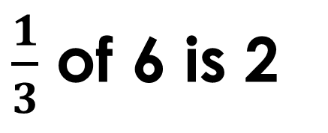
Fractions of a Quantity
Build 1
This picture shows $\frac{1}{3}$ of 6:
3 equal groups
$\frac{1}{3}$ of 6 is 2

Slide 219
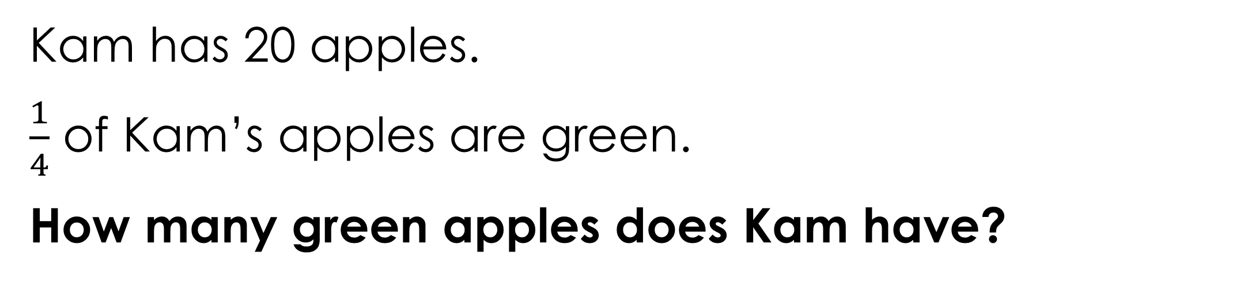
Fractions of a Quantity
Build 1
Kam has 20 apples.
$\frac{1}{4}$ of Kam’s apples are green.
How many green apples does Kam have?

Slide 220


Fractions of a Quantity
Build 1
Kam has 20 apples.
$\frac{1}{4}$ of Kam’s apples are green.
How many green apples does Kam have?
Which Picture?
4
5

Slide 221
Fractions of a Quantity
Build 1
Kam has 20 apples.
$\frac{1}{4}$ of Kam’s apples are green.
How many green apples does Kam have?
5

Slide 222
Fractions of a Quantity
Build 1
Kam has 20 apples.
$\frac{1}{4}$ of Kam’s apples are green.
How many green apples does Kam have?
Bar model:
5
20
5 | 5 | 5 | 5

Slide 223
Fractions of a Quantity
Build 1
There are 16 lights in the house.
Dots represent the lights

Slide 224
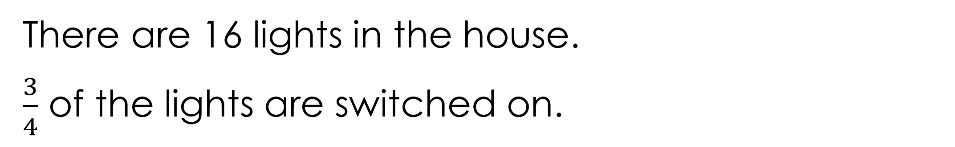
Fractions of a Quantity
Build 1
There are 16 lights in the house.
$\frac{3}{4}$ of the lights are switched on.

Slide 225
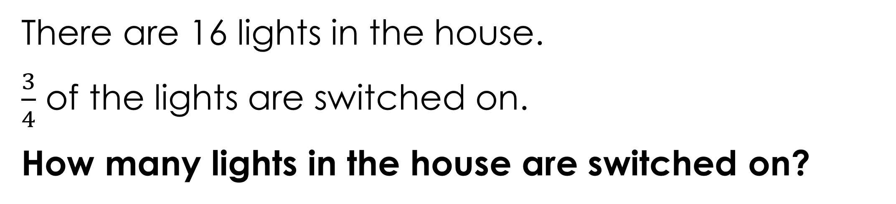
Fractions of a Quantity
Build 1
There are 16 lights in the house.
$\frac{3}{4}$ of the lights are switched on.
How many lights in the house are switched on?
Which Answer?
4
12

Slide 226
Fractions of a Quantity
Build 1
There are 16 lights in the house.
$\frac{3}{4}$ of the lights are switched on.
How many lights in the house are switched on?
12

Slide 227
Fractions of a Quantity
Build 1
There are 16 lights in the house.
$\frac{3}{4}$ of the lights are switched on.
How many lights in the house are switched on?
Bar model:
16
12
4 | 4 | 4 | 4

Slide 228

Fractions of a Quantity
Build 1
There are 9 children at the party.

Slide 229

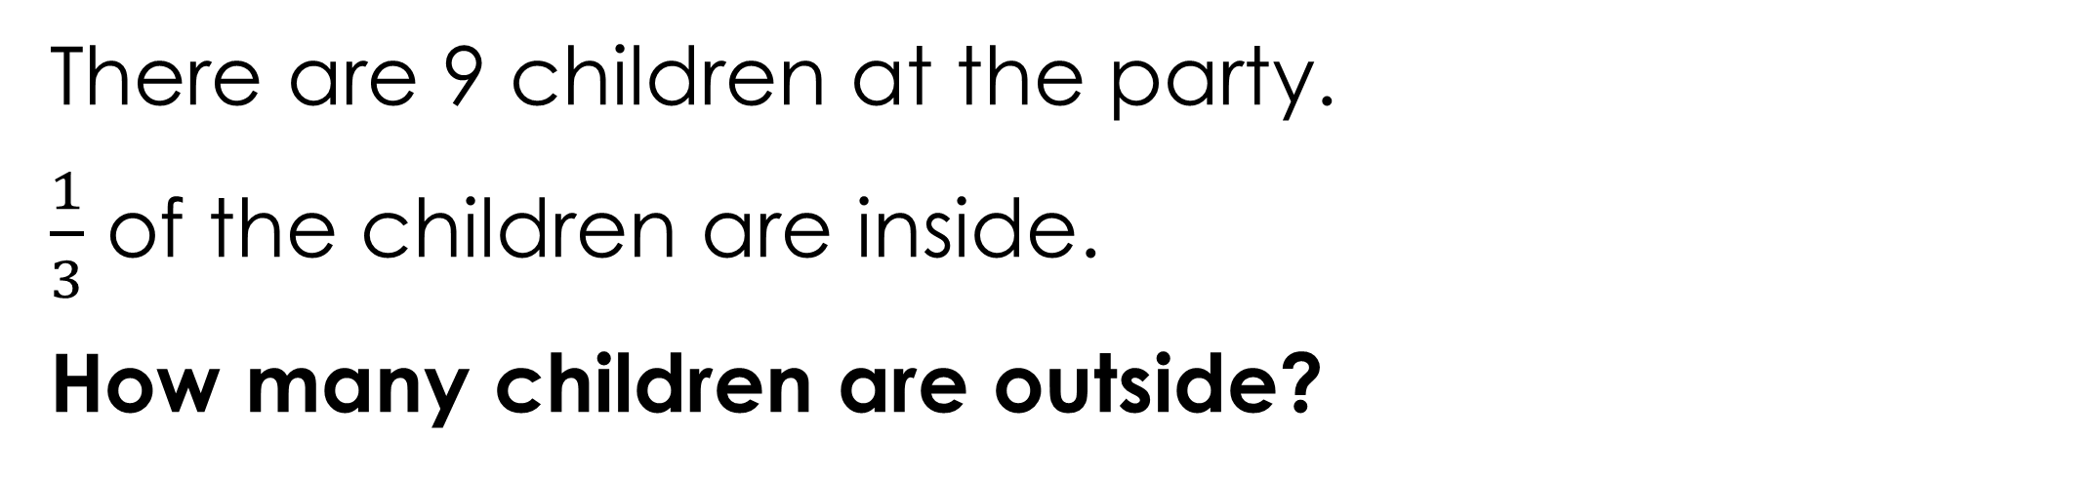
Fractions of a Quantity
Build 1
There are 9 children at the party.
$\frac{1}{3}$ of the children are inside.
How many children are outside?
What could the question be?

Slide 230
Fractions of a Quantity
Build 1
There are 9 children at the party.
$\frac{1}{3}$ of the children are inside.
How many children are outside?
Which Answer?
3
6

Slide 231
Fractions of a Quantity
Build 1
There are 9 children at the party.
$\frac{1}{3}$ of the children are inside.
How many children are outside?
6

Slide 232
Fractions of a Quantity
Build 1
There are 9 children at the party.
$\frac{1}{3}$ of the children are inside.
How many children are outside?
6
Bar model:
9
3 | 3 | 3
in
out

Slide 233
Fractions of a Quantity
Build 1
Fractions of a Quantity
Next Step: Task A

Slide 234
Fractions of a Quantity
Build 2
Fractions of a Quantity: Build 2
Compare two fractions of quantity questions, identifying important differences

Slide 235
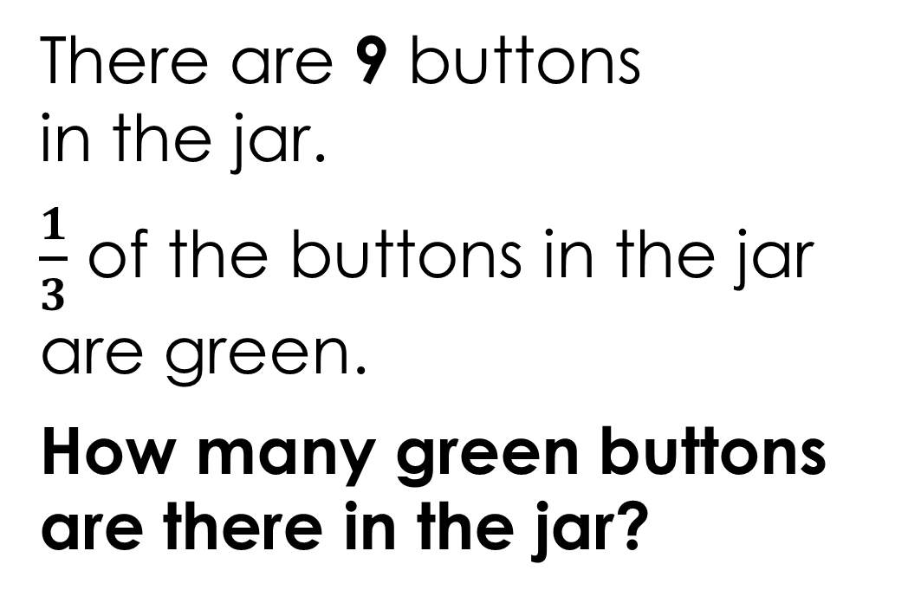
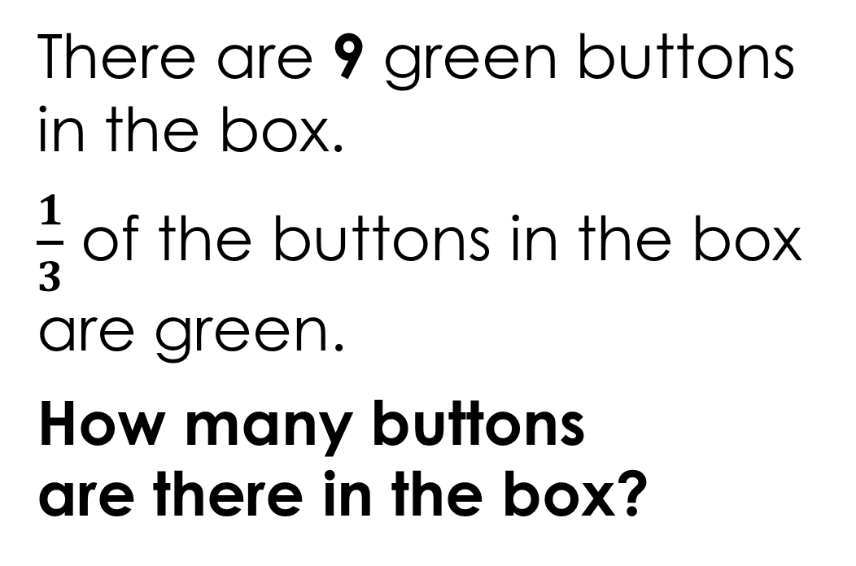
Fractions of a Quantity
Build 2
There are 9 buttons in the jar.
$\frac{1}{3}$ of the buttons in the jar are green.
How many green buttons are there in the jar?
There are 9 green buttons in the box.
$\frac{1}{3}$ of the buttons in the box are green.
How many buttons are there in the box?
What’s the same?
What’s different?

Slide 236
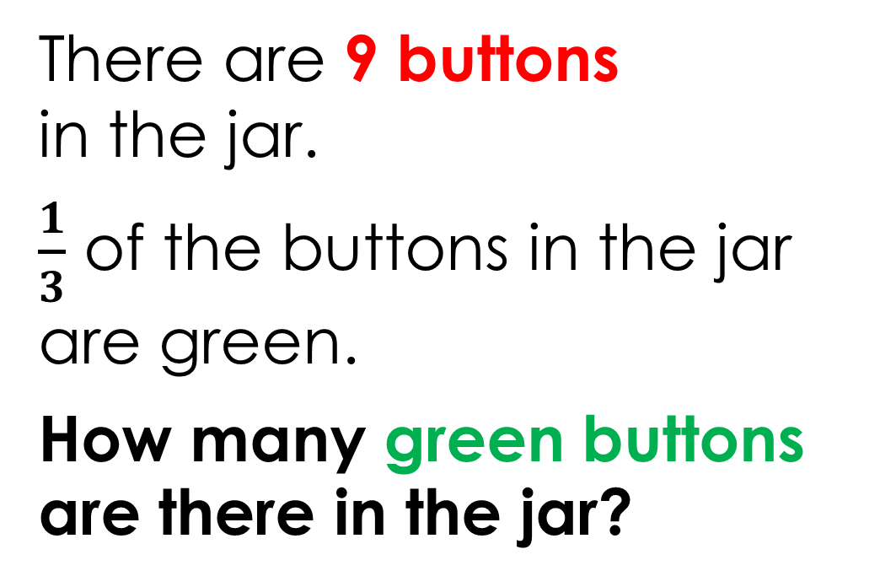
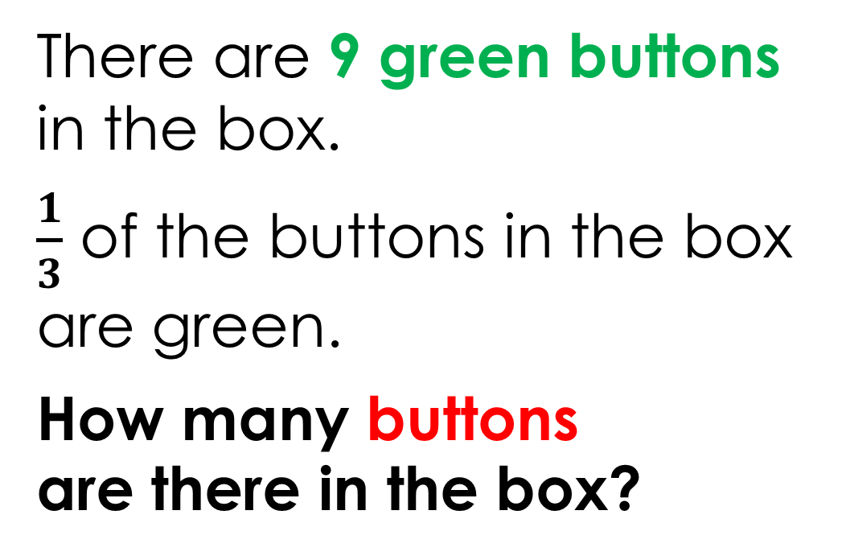
Fractions of a Quantity
Build 2
There are 9 buttons in the jar.
$\frac{1}{3}$ of the buttons in the jar are green.
How many green buttons are there in the jar?
There are 9 green buttons in the box.
$\frac{1}{3}$ of the buttons in the box are green.
How many buttons are there in the box?

Slide 237

Fractions of a Quantity
Build 2
There are 9 buttons in the jar.
$\frac{1}{3}$ of the buttons in the jar are green.
How many green buttons are there in the jar?
There are 9 green buttons in the box.
$\frac{1}{3}$ of the buttons in the box are green.
How many buttons are there in the box?

Slide 238


Fractions of a Quantity
Build 2
There are 9 buttons in the jar.
$\frac{1}{3}$ of the buttons in the jar are green.
How many green buttons are there in the jar?
There are 9 green buttons in the box.
$\frac{1}{3}$ of the buttons in the box are green.
How many buttons are there in the box?
3

Slide 239
Fractions of a Quantity
Build 2
There are 9 buttons in the jar.
$\frac{1}{3}$ of the buttons in the jar are green.
How many green buttons are there in the jar?
There are 9 green buttons in the box.
$\frac{1}{3}$ of the buttons in the box are green.
How many buttons are there in the box?
3
9
3 | 3 | 3

Slide 240
Fractions of a Quantity
Build 2
There are 9 buttons in the jar.
$\frac{1}{3}$ of the buttons in the jar are green.
How many green buttons are there in the jar?
There are 9 green buttons in the box.
$\frac{1}{3}$ of the buttons in the box are green.
How many buttons are there in the box?
3
9
3 | 3 | 3

Slide 241
Fractions of a Quantity
Build 2
There are 9 buttons in the jar.
$\frac{1}{3}$ of the buttons in the jar are green.
How many green buttons are there in the jar?
There are 9 green buttons in the box.
$\frac{1}{3}$ of the buttons in the box are green.
How many buttons are there in the box?
3
9
3 | 3 | 3

Slide 242
Fractions of a Quantity
Build 2
There are 9 buttons in the jar.
$\frac{1}{3}$ of the buttons in the jar are green.
How many green buttons are there in the jar?
There are 9 green buttons in the box.
$\frac{1}{3}$ of the buttons in the box are green.
How many buttons are there in the box?
3
9
27
27
3 | 3 | 3
9 | 9 | 9

Slide 243
Fractions of a Quantity
Build 2
Fractions of a Quantity
Next Steps:
Task B Version 1 or Task B Version 2
Extend

Slide 244
Paying with Coins
Build 1
Paying with Coins: Build 1
To understand questions that involve giving change, using the correct coins

Slide 245
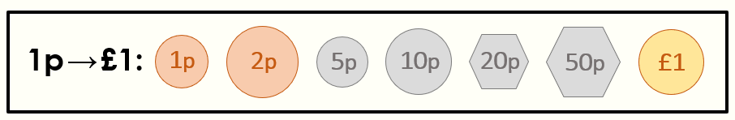
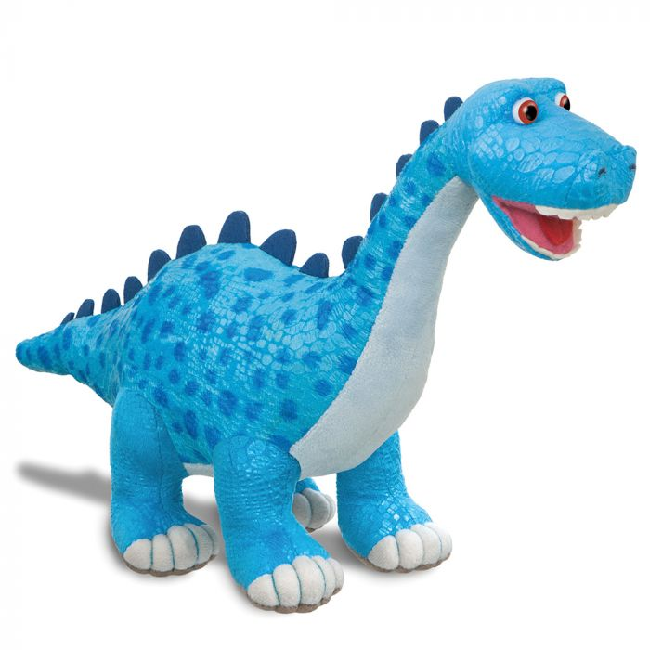
Paying with Coins
Build 1
The dinosaur costs 60p.
60 p

Slide 246
Paying with Coins
Build 1
The dinosaur costs 60p.
Which coins can you pay with?
What change could be given?
60 p

Slide 247
Paying with Coins
Build 1
The dinosaur costs 60p.
Which coins can you pay with?
What change could be given?
60 p
I could pay with this coin:
I would get this coin change:
50p
Explain the mistake:
10p

Slide 248
Paying with Coins
Build 1
The dinosaur costs 60p.
Which coins can you pay with?
What change could be given?
60 p
Pay:
50p
20p
Change: 10p
Cost: 60p
Change:
10p
Paid: 70p

Slide 249
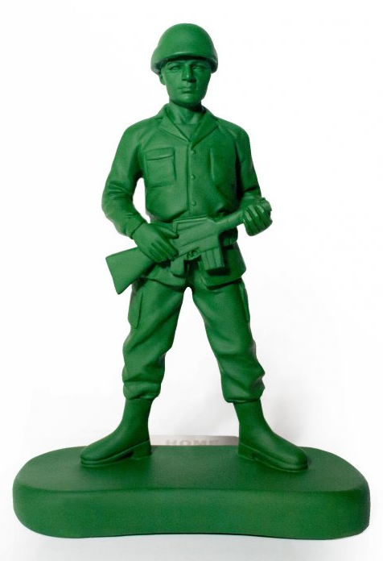
Paying with Coins
Build 1
Max buys a toy soldier for 35p.
He pays with a 50p coin.
What change could be given?
35 p

Slide 250
Paying with Coins
Build 1
Max buys a toy soldier for 35p.
He pays with a 50p coin.
What change could be given?
35 p
Which Answer?
10p
5p
20p
5p

Slide 251
Paying with Coins
Build 1
Max buys a toy soldier for 35p.
He pays with a 50p coin.
What change could be given?
35 p
10p
5p

Slide 252
Paying with Coins
Build 1
Max buys a toy soldier for 35p.
He pays with a 50p coin.
What change could be given?
35 p
Change: 15p
Cost: 35p
10p
5p
Paid: 50p

Slide 253
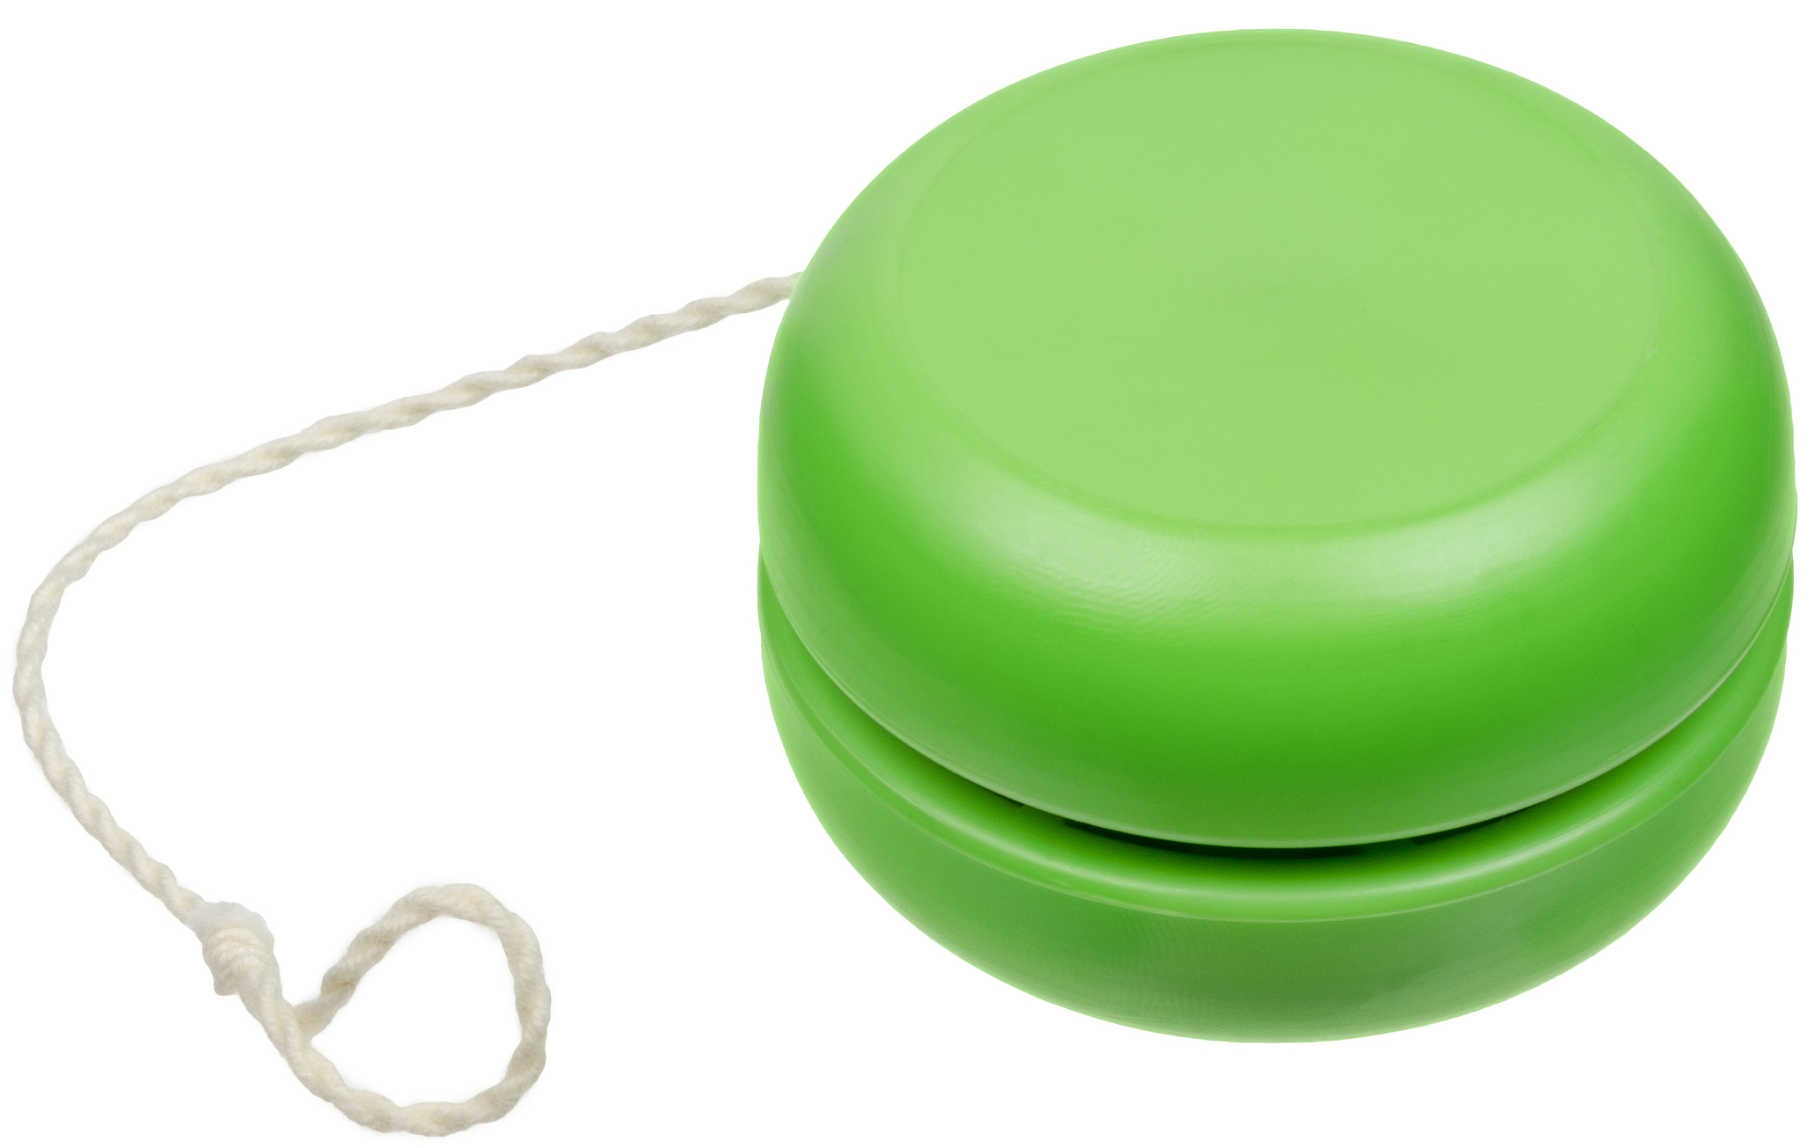
Paying with Coins
Build 1
Zara buys a yoyo for 90p.
She pays with a £1 coin.
What change could be given?
90 p

Slide 254
Paying with Coins
Build 1
Zara buys a yoyo for 90p.
She pays with a £1 coin.
What change could be given?
90 p
Which Answer?
10p
2p
2p
2p
2p
1p
1p

Slide 255
Paying with Coins
Build 1
Zara buys a yoyo for 90p.
She pays with a £1 coin.
What change could be given?
90 p
Normally this.
Could be this.
10p
2p
2p
2p
2p
1p
1p

Slide 256
Paying with Coins
Build 1
Paying with Coins
Next Step: Task A

Slide 257
Paying with Coins
Build 2
Paying with Coins: Build 2
Find different ways to give change

Slide 258
Paying with Coins
Build 2
Kate buys a pack of stickers that costs 65p.
She pays with a £1 coin.
How much change does she get?

Slide 259
Paying with Coins
Build 2
Kate buys a pack of stickers that costs 65p.
She pays with a £1 coin.
How much change does she get?
Which Answer?
Cost: 65p
Change: 35p
35p
45p
Paid: £1

Slide 260
Paying with Coins
Build 2
Kate buys a pack of stickers that costs 65p.
She pays with a £1 coin.
How much change does she get?
Cost: 65p
Change: 35p
35p
Paid: £1

Slide 261
Paying with Coins
Build 2
Kate buys a pack of stickers that costs 65p.
She pays with a £1 coin.
Show different ways that Kate could get her change:
35p

Slide 262
Paying with Coins
Build 2
Kate buys a pack of stickers that costs 65p.
She pays with a £1 coin.
Show different ways that Kate could get her change:
35p
3 coins:
20p
5p
10p

Slide 263
Paying with Coins
Build 2
Kate buys a pack of stickers that costs 65p.
She pays with a £1 coin.
Show different ways that Kate could get her change:
35p
3 coins:
4 coins:
10p
5p
20p
5p
10p
10p
10p

Slide 264
Paying with Coins
Build 2
Kate buys a pack of stickers that costs 65p.
She pays with a £1 coin.
Show different ways that Kate could get her change:
35p
3 coins:
4 coins:
5 coins:
10p
5p
20p
1p
20p
5p
2p
10p
10p
10p
10p
2p

Slide 265
Paying with Coins
Build 2
Paying with Coins
Next Steps:
Task B Version 1 or Task B Version 2
Extend

Slide 266
Multi-Step Money
Build 1
Multi-Step Money: Build 1
Understand different money questions by predicting hidden information

Slide 267

Multi-Step Money
Build 1
Bucket
£2
Spade
£1.50
Ball
£2.50
Kam wants to buy a bucket and a spade. He has £3
How much more money does Kam need?
This number is more/less than…

Slide 268
Multi-Step Money
Build 1
Bucket
£2
Spade
£1.50
Ball
£2.50
Kam wants to buy a bucket and a spade. He has £3.
How much more money does Kam need?

Slide 269
Multi-Step Money
Build 1
Bucket
£2
Spade
£1.50
Ball
£2.50
Kam wants to buy a bucket and a spade. He has £3.
How much more money does Kam need?
Which bar model?
£3
£3
?
£2 | £1.50
£2 | £1.50
?

Slide 270
Multi-Step Money
Build 1
Bucket
£2
Spade
£1.50
Ball
£2.50
Kam wants to buy a bucket and a spade. He has £3.
How much more money does Kam need?
£3
?
£2 | £1.50

Slide 271
Multi-Step Money
Build 1
Bucket
£2
Spade
£1.50
Ball
£2.50
Kam wants to buy a bucket and a spade. He has £3.
How much more money does Kam need?
£3
50p
Answer: 50p
£2 | £1.50

Slide 272
Multi-Step Money
Build 1
Bucket
£2
Spade
£1.50
Ball
£2.50
Zara bought 2 buckets and a ball. She paid with a £10 note.
How much change did Zara get?
This could be… could not be…

Slide 273
Multi-Step Money
Build 1
Bucket
£2
Spade
£1.50
Ball
£2.50
Zara bought 2 buckets and a ball. She paid with a £10 note.
How much change did Zara get?

Slide 274
Multi-Step Money
Build 1
Bucket
£2
Spade
£1.50
Ball
£2.50
Zara bought 2 buckets and a ball. She paid with a £10 note.
How much change did Zara get?
Which bar model?
£10
£10
?
£2 | £2 | £2.50
£2 | £2 | £2.50
?

Slide 275
Multi-Step Money
Build 1
Bucket
£2
Spade
£1.50
Ball
£2.50
Zara bought 2 buckets and a ball. She paid with a £10 note.
How much change did Zara get?
£10
£2 | £2 | £2.50
?

Slide 276
Multi-Step Money
Build 1
Bucket
£2
Spade
£1.50
Ball
£2.50
Zara bought 2 buckets and a ball. She paid with a £10 note.
How much change did Zara get?
£10
Answer: £3.50
£2 | £2 | £2.50
£3.50

Slide 277
Multi-Step Money
Build 1
Bucket
£2
Spade
£1.50
Ball
£2.50
Raja has £7.
How many balls can he afford?

Slide 278
Multi-Step Money
Build 1
Bucket
£2
Spade
£1.50
Ball
£2.50
Raja has £7.
How many balls can he afford?
£7
£2.50 | £2.50 | £2.50

Slide 279
Multi-Step Money
Build 1
Bucket
£2
Spade
£1.50
Ball
£2.50
Raja has £7.
How many balls can he afford?
Which Answer?
£7
2 balls
£2.50 | £2.50 | £2.50
3 balls

Slide 280
Multi-Step Money
Build 1
Bucket
£2
Spade
£1.50
Ball
£2.50
Raja has £7.
How many balls can he afford?
£7
2 balls
£2.50 | £2.50 | £2.50

Slide 281
Multi-Step Money
Build 1
Multi-Step Money
Next Step: Task A

Slide 282
Multi-Step Money
Build 2
Multi-Step Money: Build 2
Understand money questions using pictures

Slide 283


Multi-Step Money
Build 2
Banana
15p
Apple
20p
Orange
35p
Jack wants to buy 3 apples and an orange.
He has £1.

Slide 284
Multi-Step Money
Build 2
Banana
15p
Apple
20p
Orange
35p
Jack wants to buy 3 apples and an orange.
He has £1.
Jack will get some change
Jack needs more money
OR

Slide 285
Multi-Step Money
Build 2
Banana
15p
Apple
20p
Orange
35p
Jack wants to buy 3 apples and an orange.
He has £1.
Jack will get some change
£1
20p | 20p | 20p | 35p

Slide 286
Multi-Step Money
Build 2
Banana
15p
Apple
20p
Orange
35p
Jack wants to buy 3 apples and an orange.
He has £1.
Jack will get some change
£1
Answer: 5p
20p | 20p | 20p | 35p

Slide 287
Multi-Step Money
Build 2
Banana
15p
Apple
20p
Orange
35p
Eve wants to buy some bananas. She has 50p.
How many bananas can Eve afford?

Slide 288
Multi-Step Money
Build 2
Banana
15p
Apple
20p
Orange
35p
Eve wants to buy some bananas. She has 50p.
How many bananas can Eve afford?
1 banana = 15p
2 bananas = 30p
3 bananas = 45p
4 bananas = 60p

Slide 289
Multi-Step Money
Build 2
Banana
15p
Apple
20p
Orange
35p
Eve wants to buy some bananas. She has 50p.
How many bananas can Eve afford?
1 banana = 15p
2 bananas = 30p
3 bananas = 45p
4 bananas = 60p
50p
15p | 15p | 15p | 15p

Slide 290
Multi-Step Money
Build 2
Banana
15p
Apple
20p
Orange
35p
Eve wants to buy some bananas. She has 50p.
How many bananas can Eve afford?
1 banana = 15p
2 bananas = 30p
3 bananas = 45p
4 bananas = 60p
50p
15p | 15p | 15p | 15p

Slide 291
Multi-Step Money
Build 2
Multi-Step Money
Next Steps:
Task B Version 1 or Task B Version 2
Extend

Slide 292
Time Calculation
Build 1
Time Calculation: Build 1
Answer different questions involving time and explain common mistakes

Slide 293
Time Calculation
Build 1
Jen set off on a run at 4:30pm.
Jen finished her run at 5:30pm.
How long, in minutes, was Jen running?
What could the question be?

Slide 294
Time Calculation
Build 1
Jen set off on a run at 4:30pm.
Jen finished her run at 5:30pm.
How long, in minutes, was Jen running?
Which Answer?
60 minutes
100 minutes
For the incorrect answer, explain the mistake.

Slide 295
Time Calculation
Build 1
Jen set off on a run at 4:30pm.
Jen finished her run at 5:30pm.
How long, in minutes, was Jen running?
60 minutes
1 hour = 60 minutes (not 100 minutes)

Slide 296
Time Calculation
Build 1
Owl class went on a school trip to the zoo.
They arrived at the zoo at 10:10am.
The coach journey was 40 minutes long.
At what time did Owl class set off?
What information could be here?

Slide 297
Time Calculation
Build 1
Owl class went on a school trip to the zoo.
They arrived at the zoo at 10:10am.
The coach journey was 40 minutes long.
At what time did Owl class set off?
Which Answer?
9:30 am
10:50 am
For the incorrect answer, explain the mistake.

Slide 298
Time Calculation
Build 1
Owl class went on a school trip to the zoo.
They arrived at the zoo at 10:10am.
The coach journey was 40 minutes long.
At what time did Owl class set off?
30 minutes
10 minutes
9:30 am
9:30am
10:00am
10:10am

Slide 299
Time Calculation
Build 1
It takes Kam 20 minutes to walk to work.
Kam left home at 8 : 50 am.
At what time did Kam arrive at work?

Slide 300
Time Calculation
Build 1
It takes Kam 20 minutes to walk to work.
Kam left home at 8 : 50 am.
At what time did Kam arrive at work?
Which Answer?
8:70 am
9:10 am
For the incorrect answer, explain the mistake.

Slide 301
Time Calculation
Build 1
It takes Kam 20 minutes to walk to work.
Kam left home at 8 : 50 am.
At what time did Kam arrive at work?
9:10 am

Slide 302
Time Calculation
Build 1
It takes Kam 20 minutes to walk to work.
Kam left home at 8 : 50 am.
At what time did Kam arrive at work?
9:10 am
10 minutes
10 minutes
8:50am
9:00am
9:10am

Slide 303
Time Calculation
Build 1
Time Calculation
Next Step: Task A

Slide 304
Time Calculation
Build 2
Time Calculation: Build 2
Compare time questions that do/don’t border over an hour

Slide 305
Time Calculation
Build 2
Beth went on a bike ride.
She set off at 3:10 pm.
She arrived home at 3:50 pm.
How long, in minutes, was Beth’s bike ride?

Slide 306
Time Calculation
Build 2
Beth went on a bike ride.
She set off at 3:10 pm.
She arrived home at 3:50 pm.
How long, in minutes, was Beth’s bike ride?
Rose went on a bike ride.
She set off at 3:40 pm.
She arrived home at 4:10 pm.
How long, in minutes, was Rose’s bike ride?
Which question is easiest to answer?

Slide 307
Time Calculation
Build 2
Beth went on a bike ride.
She set off at 3:10 pm.
She arrived home at 3:50 pm.
How long, in minutes, was Beth’s bike ride?
Rose went on a bike ride.
She set off at 3:40 pm.
She arrived home at 4:10 pm.
How long, in minutes, was Rose’s bike ride?

Slide 308
Time Calculation
Build 2
Beth went on a bike ride.
She set off at 3:10 pm.
She arrived home at 3:50 pm.
How long, in minutes, was Beth’s bike ride?
Rose went on a bike ride.
She set off at 3:40 pm.
She arrived home at 4:10 pm.
How long, in minutes, was Rose’s bike ride?
Answer: 40 minutes
40 minutes
3:10pm
3:50pm

Slide 309
Time Calculation
Build 2
Beth went on a bike ride.
She set off at 3:10 pm.
She arrived home at 3:50 pm.
How long, in minutes, was Beth’s bike ride?
Rose went on a bike ride.
She set off at 3:40 pm.
She arrived home at 4:10 pm.
How long, in minutes, was Rose’s bike ride?
Answer: 40 minutes
40 minutes
20 minutes
3:10pm
3:50pm
3:40pm
4:00pm

Slide 310
Time Calculation
Build 2
Beth went on a bike ride.
She set off at 3:10 pm.
She arrived home at 3:50 pm.
How long, in minutes, was Beth’s bike ride?
Rose went on a bike ride.
She set off at 3:40 pm.
She arrived home at 4:10 pm.
How long, in minutes, was Rose’s bike ride?
Answer: 40 minutes
Answer: 30 minutes
40 minutes
20 minutes
10 minutes
3:10pm
3:50pm
3:40pm
4:00pm
4:10pm

Slide 311
Time Calculation
Build 2
Time Calculation
Next Steps:
Task B Version 1 or Task B Version 2
Extend

Slide 312
Days and Months
Build 1
Days and Months: Build 1
Answer different questions where you must know the number of days in each month

Slide 313
Days and Months
Build 1
January: 31 days
February: 28 or 29 days
March: 31 days
April: 30 days
May: 31 days
June: 30 days
July: 31 days
August: 31 days
September: 30 days
October: 31 days
November: 30 days
December: 31 days
Look at what the colours represent.
Talk about which months are in spring, summer, autumn and winter.

Slide 314
Days and Months
Build 1
January
February
March
April
May
June
July
August
September
October
November
December
This month has 31 days.
This month is after the summer.
Christmas is not in this month.
Which month(s) could it be?

Slide 315
Days and Months
Build 1
January
February
March
April
May
June
July
August
September
October
November
December
This month has 31 days.
This month is after the summer.
Christmas is not in this month.
Which month(s) could it be?
Answer: October

Slide 316
Days and Months
Build 1
January
February
March
April
May
June
July
August
September
October
November
December
This month has 30 days.
This month is before October.
Easter is never in this month.
Which month(s) could it be?

Slide 317
Days and Months
Build 1
January
February
March
April
May
June
July
August
September
October
November
December
This month has 30 days.
This month is before October.
Easter is never in this month.
Which month(s) could it be?
Answer: June or September

Slide 318
Days and Months
Build 1
May
January
February
March
April
May
June
July
August
September
October
November
December
Monday | Tuesday | Wednesday | Thursday | Friday | Saturday | Sunday
 |  | 1st | 2nd | 3rd | 4th | 5th
6th | 7th | 8th | 9th | 10th | 11th | 12th
13th | 14th | 15th | 16th | 17th | 18th | 19th
20th | 21st | 22nd | 23rd | 24th | 25th | 26th
27th | 28th | 29th | 30th | 31st
The first day of May is a Wednesday.
The last day of May is a Friday.

Slide 319
Days and Months
Build 1
May
January
February
March
April
May
June
July
August
September
October
November
December
Monday | Tuesday | Wednesday | Thursday | Friday | Saturday | Sunday
 |  | 1st | 2nd | 3rd | 4th | 5th
6th | 7th | 8th | 9th | 10th | 11th | 12th
13th | 14th | 15th | 16th | 17th | 18th | 19th
20th | 21st | 22nd | 23rd | 24th | 25th | 26th
27th | 28th | 29th | 30th | 31st
The first day of May is a Wednesday.
The last day of May is a Friday.

Slide 320
Days and Months
Build 1
Days and Months
Next Step: Task A

Slide 321
Days and Months
Build 2
Days and Months: Build 2
Answer different questions where you must know the number of days in each month

Slide 322
Days and Months
Build 2
November
January
February
March
April
May
June
July
August
September
October
November
December
Monday | Tuesday | Wednesday | Thursday | Friday | Saturday | Sunday
 |  |  | 1st | 2nd | 3rd | 4th
5th | 6th | 7th | 8th | 9th | 10th | 11th
12th | 13th | 14th | 15th | 16th | 17th | 18th
19th | 20th | 21st | 22nd | 23rd | 24th | 25th
26th | 27th | 28th | 29th | 30th
The last day of October was a Wednesday.
The first day of December is a Saturday.

Slide 323
Days and Months
Build 2
31st October
November
January
February
March
April
May
June
July
August
September
October
November
December
Monday | Tuesday | Wednesday | Thursday | Friday | Saturday | Sunday
 |  |  | 1st | 2nd | 3rd | 4th
5th | 6th | 7th | 8th | 9th | 10th | 11th
12th | 13th | 14th | 15th | 16th | 17th | 18th
19th | 20th | 21st | 22nd | 23rd | 24th | 25th
26th | 27th | 28th | 29th | 30th
The last day of October was a Wednesday.
The first day of December is a Saturday.

Slide 324
Days and Months
Build 2
31st October
November
January
February
March
April
May
June
July
August
September
October
November
December
Monday | Tuesday | Wednesday | Thursday | Friday | Saturday | Sunday
 |  |  | 1st | 2nd | 3rd | 4th
5th | 6th | 7th | 8th | 9th | 10th | 11th
12th | 13th | 14th | 15th | 16th | 17th | 18th
19th | 20th | 21st | 22nd | 23rd | 24th | 25th
26th | 27th | 28th | 29th | 30th
1st December
The last day of October was a Wednesday.
The first day of December is a Saturday.

Slide 325
Days and Months
Build 2
January
February
March
April
May
June
July
August
September
October
November
December
Max went to Italy on 24th July.
Max returned home from Italy after 1 week.
or
Max got back home in July
Max got back home in August

Slide 326
Days and Months
Build 2
January
February
March
April
May
June
July
August
September
October
November
December
Max went to Italy on 24th July.
Max returned home from Italy after 1 week.
Max got back home in July
Max got back home in August
1 week after 24th July it is 31st July.

Slide 327
Days and Months
Build 2
January
February
March
April
May
June
July
August
September
October
November
December
Jen went to Spain on 20th September.
Jen was in Spain for 2 weeks.
Jen came home in October.
What information could be here?
There are different possibilities.

Slide 328
Days and Months
Build 2
January
February
March
April
May
June
July
August
September
October
November
December
Jen went to Spain on 20th September.
Jen was in Spain for 2 weeks.
Jen came home in October.
Could the missing information be…
or
11 days
2 months
2 weeks

Slide 329
Days and Months
Build 2
January
February
March
April
May
June
July
August
September
October
November
December
Jen went to Spain on 20th September.
Jen was in Spain for 2 weeks.
Jen came home in October.
Could the missing information be…
11 days
2 months
2 weeks

Slide 330
Days and Months
Build 2
January
February
March
April
May
June
July
August
September
October
November
December
Jen went to Spain on 20th September.
Jen was in Spain for 2 weeks.
Jen came home in October.

Slide 331
Days and Months
Build 2
Days and Months
Next Steps:
Task B Version 1 or Task B Version 2
Extend

Slide 332
Interpreting Graphs
Build 1
Interpreting Graphs: Build 1
Compare a pictogram and a bar graph, identifying advantages/disadvantages

Slide 333

Interpreting Graphs
Build 1
The pictogram shows how the children at Marton Primary travel to school:
Walk
Car
Bus
Bike
= 10 children

Slide 334
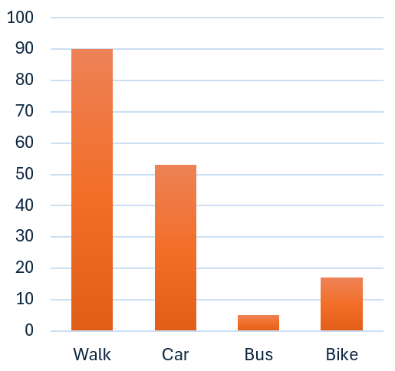
Interpreting Graphs
Build 1
The bar graph shows how the children at Marton Primary travel to school:

Slide 335
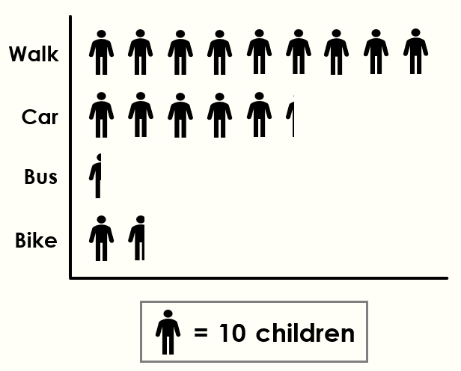
Interpreting Graphs
Build 1
How many children ride a bike?

Slide 336
Interpreting Graphs
Build 1
How many children ride a bike?
Answer: 17

Slide 337
Interpreting Graphs
Build 1
How many more children walk than come by car?

Slide 338
Interpreting Graphs
Build 1
How many more children walk than come by car?
Answer: 37

Slide 339
Interpreting Graphs
Build 1
How many children walk or ride a bike?

Slide 340
Interpreting Graphs
Build 1
How many children walk or ride a bike?
Answer: 107

Slide 341
Interpreting Graphs
Build 1
Which graph is easier to read? Why?

Slide 342
Interpreting Graphs
Build 1
Interpreting Graphs
Next Step: Task A

Slide 343
Interpreting Graphs
Build 2
Interpreting Graphs: Build 2
Understand graph questions by predicting what the hidden information could be

Slide 344
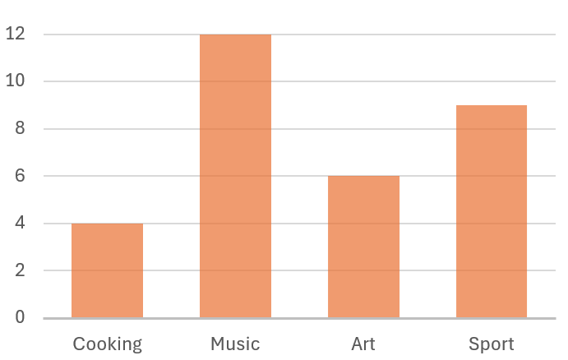
Interpreting Graphs
Build 2
What is the hidden information?
Favourite Hobbies
9 people chose sport.
Fewer people chose sport than music.

Slide 345
Interpreting Graphs
Build 2
What is the hidden information?
Favourite Hobbies
9 people chose sport.
Fewer people chose sport than music.

Slide 346
Interpreting Graphs
Build 2
What is the hidden information?
Favourite Hobbies
9 people chose sport.
Fewer people chose sport than music.

Slide 347
Interpreting Graphs
Build 2
What is the hidden information?
Favourite Hobbies
9 people chose sport.
Fewer people chose sport than music.
2 more people chose art than cooking.
18 people chose music or art.

Slide 348
Interpreting Graphs
Build 2
What is the hidden information?
Favourite Hobbies
9 people chose sport.
Fewer people chose sport than music.
2 more people chose art than cooking.
18 people chose music or art.

Slide 349
Interpreting Graphs
Build 2
What is the hidden information?
Favourite Hobbies
9 people chose sport.
Fewer people chose sport than music.
2 more people chose art than cooking.
18 people chose music or art.

Slide 350
Interpreting Graphs
Build 2
Interpreting Graphs
Next Steps:
Task B Version 1 or Task B Version 2
Extend

Slide 351
Interpreting Tables
Build 1
Interpreting Tables: Build 1
Identify the pieces of information needed to answer the question

Slide 352
Interpreting Tables
Build 1
The Y1 → Y3 children of Marton Primary School were asked if they can ride a bike. This table shows the results:
 | Y1 | Y2 | Y3 | Y4
Yes | 5 | 9 | 15 | 21
No | 21 | 16 | 12 | 8

Slide 353
Interpreting Tables
Build 1
The Y1 → Y3 children of Marton Primary School were asked if they can ride a bike. This table shows the results:
 | Y1 | Y2 | Y3 | Y4
Yes | 5 | 9 | 15 | 21
No | 21 | 16 | 12 | 8
To answer this question…
Read 1 box
Read 2 boxes
Read more than 2 boxes
Do this first.
How many children in Y3 can’t ride a bike?

Slide 354
Interpreting Tables
Build 1
The Y1 → Y3 children of Marton Primary School were asked if they can ride a bike. This table shows the results:
 | Y1 | Y2 | Y3 | Y4
Yes | 5 | 9 | 15 | 21
No | 21 | 16 | 12 | 8
To answer this question…
Read 1 box
Read 2 boxes
Read more than 2 boxes
How many children in Y3 can’t ride a bike?

Slide 355
Interpreting Tables
Build 1
The Y1 → Y3 children of Marton Primary School were asked if they can ride a bike. This table shows the results:
 | Y1 | Y2 | Y3 | Y4
Yes | 5 | 9 | 15 | 21
No | 21 | 16 | 12 | 8
To answer this question…
Read 1 box
Read 2 boxes
Read more than 2 boxes
How many children in Y3 can’t ride a bike?
Answer: 12 children

Slide 356
Interpreting Tables
Build 1
The Y1 → Y3 children of Marton Primary School were asked if they can ride a bike. This table shows the results:
 | Y1 | Y2 | Y3 | Y4
Yes | 5 | 9 | 15 | 21
No | 21 | 16 | 12 | 8
To answer this question…
Read 1 box
Read 2 boxes
Read more than 2 boxes
Do this first.
How many children are there in Y1?

Slide 357
Interpreting Tables
Build 1
The Y1 → Y3 children of Marton Primary School were asked if they can ride a bike. This table shows the results:
 | Y1 | Y2 | Y3 | Y4
Yes | 5 | 9 | 15 | 21
No | 21 | 16 | 12 | 8
To answer this question…
Read 1 box
Read 2 boxes
Read more than 2 boxes
How many children are there in Y1?

Slide 358
Interpreting Tables
Build 1
The Y1 → Y3 children of Marton Primary School were asked if they can ride a bike. This table shows the results:
 | Y1 | Y2 | Y3 | Y4
Yes | 5 | 9 | 15 | 21
No | 21 | 16 | 12 | 8
To answer this question…
Read 1 box
Read 2 boxes
Read more than 2 boxes
How many children are there in Y1?
Answer: 26 children

Slide 359
Interpreting Tables
Build 1
The Y1 → Y3 children of Marton Primary School were asked if they can ride a bike. This table shows the results:
 | Y1 | Y2 | Y3 | Y4
Yes | 5 | 9 | 15 | 21
No | 21 | 16 | 12 | 8
To answer this question…
Read 1 box
Read 2 boxes
Read more than 2 boxes
Do this first.
How many more children in Y3 can ride a bike than can’t ride a bike?

Slide 360
Interpreting Tables
Build 1
The Y1 → Y3 children of Marton Primary School were asked if they can ride a bike. This table shows the results:
 | Y1 | Y2 | Y3 | Y4
Yes | 5 | 9 | 15 | 21
No | 21 | 16 | 12 | 8
To answer this question…
Read 1 box
Read 2 boxes
Read more than 2 boxes
How many more children in Y3 can ride a bike than can’t ride a bike?

Slide 361
Interpreting Tables
Build 1
The Y1 → Y3 children of Marton Primary School were asked if they can ride a bike. This table shows the results:
 | Y1 | Y2 | Y3 | Y4
Yes | 5 | 9 | 15 | 21
No | 21 | 16 | 12 | 8
To answer this question…
Read 1 box
Read 2 boxes
Read more than 2 boxes
How many more children in Y3 can ride a bike than can’t ride a bike?
Answer: 3 more children

Slide 362
Interpreting Tables
Build 1
The Y1 → Y3 children of Marton Primary School were asked if they can ride a bike. This table shows the results:
 | Y1 | Y2 | Y3 | Y4
Yes | 5 | 9 | 15 | 21
No | 21 | 16 | 12 | 8
To answer this question…
Read 1 box
Read 2 boxes
Read more than 2 boxes
Do this first.
How many children in Y1 → Y4 can ride a bike?

Slide 363
Interpreting Tables
Build 1
The Y1 → Y3 children of Marton Primary School were asked if they can ride a bike. This table shows the results:
 | Y1 | Y2 | Y3 | Y4
Yes | 5 | 9 | 15 | 21
No | 21 | 16 | 12 | 8
To answer this question…
Read 1 box
Read 2 boxes
Read more than 2 boxes
How many children in Y1 → Y4 can ride a bike?

Slide 364
Interpreting Tables
Build 1
The Y1 → Y3 children of Marton Primary School were asked if they can ride a bike. This table shows the results:
 | Y1 | Y2 | Y3 | Y4
Yes | 5 | 9 | 15 | 21
No | 21 | 16 | 12 | 8
To answer this question…
Read 1 box
Read 2 boxes
Read more than 2 boxes
How many children in Y1 → Y4 can ride a bike?
Answer: 50 children

Slide 365
Interpreting Tables
Build 1
Interpreting Tables
Next Step: Task A

Slide 366
Interpreting Tables
Build 2
Interpreting Tables: Build 2
Find the correct answer and explain common mistakes

Slide 367
Interpreting Tables
Build 2
Monday Tuesday Wednesday Thursday Friday Saturday Sunday
Which days are the weekend?

Slide 368
Interpreting Tables
Build 2
Monday Tuesday Wednesday Thursday Friday Saturday Sunday
Which days are the weekend? Answer: Saturday and Sunday

Slide 369
Interpreting Tables
Build 2
A drama group performed ‘Cinderella’. They performed the play four times, from Thursday to Sunday.
This table shows the number of people who came to each performance:
 | Thursday | Friday | Saturday | Sunday
Children | 23 | 27 | 30 | 40
Adults | 21 | 19 | 25 | 30

Slide 370
Interpreting Tables
Build 2
A drama group performed ‘Cinderella’. They performed the play four times, from Thursday to Sunday.
This table shows the number of people who came to each performance:
 | Thursday | Friday | Saturday | Sunday
Children | 23 | 27 | 30 | 40
Adults | 21 | 19 | 25 | 30
How many people watched Cinderella on Thursday?

Slide 371
Interpreting Tables
Build 2
A drama group performed ‘Cinderella’. They performed the play four times, from Thursday to Sunday.
This table shows the number of people who came to each performance:
 | Thursday | Friday | Saturday | Sunday
Children | 23 | 27 | 30 | 40
Adults | 21 | 19 | 25 | 30
Which Answer?
How many people watched Cinderella on Thursday?
21
23
44

Slide 372
Interpreting Tables
Build 2
A drama group performed ‘Cinderella’. They performed the play four times, from Thursday to Sunday.
This table shows the number of people who came to each performance:
 | Thursday | Friday | Saturday | Sunday
Children | 23 | 27 | 30 | 40
Adults | 21 | 19 | 25 | 30
How many people watched Cinderella on Thursday?
44

Slide 373
Interpreting Tables
Build 2
A drama group performed ‘Cinderella’. They performed the play four times, from Thursday to Sunday.
This table shows the number of people who came to each performance:
 | Thursday | Friday | Saturday | Sunday
Children | 23 | 27 | 30 | 40
Adults | 21 | 19 | 25 | 30
How many people watched Cinderella on the weekend?

Slide 374
Interpreting Tables
Build 2
A drama group performed ‘Cinderella’. They performed the play four times, from Thursday to Sunday.
This table shows the number of people who came to each performance:
 | Thursday | Friday | Saturday | Sunday
Children | 23 | 27 | 30 | 40
Adults | 21 | 19 | 25 | 30
Which Answer?
How many people watched Cinderella on the weekend?
30 + 40 = 70
30 + 40 + 25 + 30
= 125

Slide 375
Interpreting Tables
Build 2
A drama group performed ‘Cinderella’. They performed the play four times, from Thursday to Sunday.
This table shows the number of people who came to each performance:
 | Thursday | Friday | Saturday | Sunday
Children | 23 | 27 | 30 | 40
Adults | 21 | 19 | 25 | 30
How many people watched Cinderella on the weekend?
30 + 40 + 25 + 30
= 125

Slide 376
Interpreting Tables
Build 2
A drama group performed ‘Cinderella’. They performed the play four times, from Thursday to Sunday.
This table shows the number of people who came to each performance:
 | Thursday | Friday | Saturday | Sunday
Children | 23 | 27 | 30 | 40
Adults | 21 | 19 | 25 | 30
How many children watched Cinderella on Friday or Saturday?

Slide 377
Interpreting Tables
Build 2
A drama group performed ‘Cinderella’. They performed the play four times, from Thursday to Sunday.
This table shows the number of people who came to each performance:
 | Thursday | Friday | Saturday | Sunday
Children | 23 | 27 | 30 | 40
Adults | 21 | 19 | 25 | 30
Which Answer?
How many children watched Cinderella on Friday or Saturday?
27 or 30
57

Slide 378
Interpreting Tables
Build 2
A drama group performed ‘Cinderella’. They performed the play four times, from Thursday to Sunday.
This table shows the number of people who came to each performance:
 | Thursday | Friday | Saturday | Sunday
Children | 23 | 27 | 30 | 40
Adults | 21 | 19 | 25 | 30
How many children watched Cinderella on Friday or Saturday?
57

Slide 379
Interpreting Tables
Build 2
Interpreting Tables
Next Steps:
Task B Version 1 or Task B Version 2
Extend

