Slide 1
Task 1: Which Picture?
Note for Teacher
The focus is discerning between addition and subtraction context questions.
For each question, the information (blue box) and question (red box) are slowly revealed. Once the question is revealed, children identify the picture that represents the question.
Then, there are questions for matching the question to the picture or children can represent questions using double-sided counters (see PDF file).

Slide 2
Task 1: Which Picture?
There are 6 children at the park.
There are 2 adults at the park.
How many people at the park?

Slide 3
Task 1: Which Picture?
There are 6 children at the park.
There are 2 adults at the park.
How many people at the park?

Slide 4
Task 1: Which Picture?
There are 6 children at the park.
There are 2 adults at the park.
How many people at the park?

Slide 5
Task 1: Which Picture?
There are 6 children at the park.
There are 2 adults at the park.
How many people at the park?
6 + 2
6 – 2
Which Picture?

Slide 6
Task 1: Which Picture?
There are 6 children at the park.
There are 2 adults at the park.
How many people at the park?
6 + 2

Slide 7
Task 1: Which Picture?
Jen has 6 cats.
2 of the cats are inside.
How many cats are outside?

Slide 8
Task 1: Which Picture?
Jen has 6 cats.
2 of the cats are inside.
How many cats are outside?

Slide 9
Task 1: Which Picture?
Jen has 6 cats.
2 of the cats are inside.
How many cats are outside?

Slide 10
Task 1: Which Picture?
Jen has 6 cats.
2 of the cats are inside.
How many cats are outside?
6 + 2
6 – 2
Which Picture?

Slide 11
Task 1: Which Picture?
Jen has 6 cats.
2 of the cats are inside.
How many cats are outside?
6 – 2

Slide 12
Task 1: Which Picture?
In total, Max and Dan have 6 sweets.
Max has 2 sweets.
How many sweets does Dan have?

Slide 13
Task 1: Which Picture?
In total, Max and Dan have 6 sweets.
Max has 2 sweets.
How many sweets does Dan have?

Slide 14
Task 1: Which Picture?
In total, Max and Dan have 6 sweets.
Max has 2 sweets.
How many sweets does Dan have?

Slide 15
Task 1: Which Picture?
In total, Max and Dan have 6 sweets.
Max has 2 sweets.
How many sweets does Dan have?
6 + 2
6 – 2
Which Picture?

Slide 16
Task 1: Which Picture?
In total, Max and Dan have 6 sweets.
Max has 2 sweets.
How many sweets does Dan have?
6 – 2

Slide 17
Task 1: Which Picture?
Kate has 6 grapes.
Mel has 2 grapes.
How many grapes do they have in total?

Slide 18
Task 1: Which Picture?
Kate has 6 grapes.
Mel has 2 grapes.
How many grapes do they have in total?

Slide 19
Task 1: Which Picture?
Kate has 6 grapes.
Mel has 2 grapes.
How many grapes do they have in total?

Slide 20
Task 1: Which Picture?
Kate has 6 grapes.
Mel has 2 grapes.
How many grapes do they have in total?
6 + 2
6 – 2
Which Picture?

Slide 21
Task 1: Which Picture?
Kate has 6 grapes.
Mel has 2 grapes.
How many grapes do they have in total?
6 + 2

Slide 22
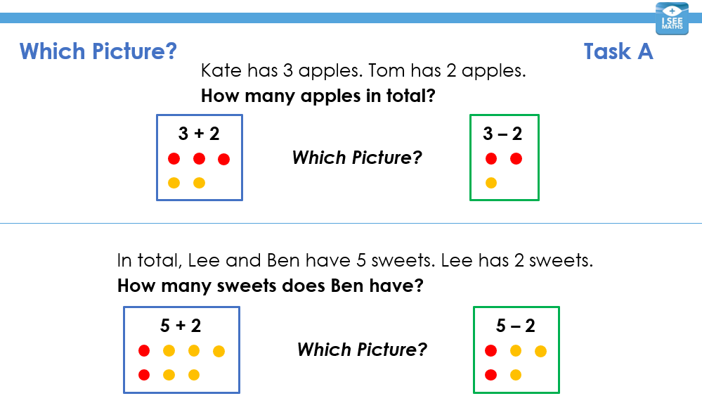
Children’s Task:

Slide 23
Task 2: Which Picture?
Question: | Picture: | Number Sentence:
 |  | 5 + 4 OR 5 – 4
Zara has 5 marbles.
Joy has 4 marbles.
How many marbles do Zara and Joy have altogether?

Slide 24
Task 2: Which Picture?
Question: | Picture: | Number Sentence:
 |  | 5 + 4 OR 5 – 4
Zara has 5 marbles.
Joy has 4 marbles.
How many marbles do Zara and Joy have altogether?

Slide 25
Task 2: Which Picture?
Question: | Picture: | Number Sentence:
 |  | 5 + 4 OR 5 – 4
Zara has 5 marbles.
Joy has 4 marbles.
How many marbles do Zara and Joy have altogether?

Slide 26
Task 2: Which Picture?
Question: | Picture: | Number Sentence:
There are 7 people in the house. 3 people are upstairs. How many people downstairs? |  | 7 + 3 OR 7 – 3

Slide 27
Task 2: Which Picture?
Question: | Picture: | Number Sentence:
There are 7 people in the house. 3 people are upstairs. How many people downstairs? |  | 7 + 3 OR 7 – 3

Slide 28
Task 2: Which Picture?
Question: | Picture: | Number Sentence:
There are 7 people in the house. 3 people are upstairs. How many people downstairs? |  | 7 + 3 OR 7 – 3

Slide 29
Children’s Task:

Slide 30
Task 2: Missing Words
Note for Teacher
The children are shown a word question with either a piece of information or the question hidden. Then, two options appear for what the missing information/question could be. Children choose between these options.
Then, there are questions for matching the question to the picture or children can represent questions using double-sided counters (see PDF file).

Slide 31
Task 2: Missing Words
Tom had 7 birthday balloons.
Then, 3 popped.
How many balloons are left?
information
question

Slide 32
Task 2: Missing Words
Tom had 7 birthday balloons.
Then, 3 popped.
How many balloons are left?
question

Slide 33
Task 2: Missing Words
Tom had 7 birthday balloons.
Then, 3 popped.
How many balloons are left?
question
How many balloons are left?
Tom was given 2 more balloons.
OR

Slide 34
Task 2: Missing Words
Tom had 7 birthday balloons.
Then, 3 popped.
How many balloons are left?

Slide 35
Task 2: Missing Words
Tom had 7 birthday balloons.
Then, 3 popped.
How many balloons are left?

Slide 36
Task 2: Missing Words
Tom had 7 birthday balloons.
Then, 3 popped.
How many balloons are left?

Slide 37
Task 2: Missing Words
Tom had 7 birthday balloons.
Then, 3 popped.
How many balloons are left?
Answer: 4 balloons

Slide 38
Task 2: Missing Words
There were 6 people at the park.
There were 4 children at the park.
How many adults at the park?
information
question

Slide 39
Task 2: Missing Words
There were 6 people at the park.
There were 4 children at the park.
How many adults at the park?
information

Slide 40
Task 2: Missing Words
There were 6 people at the park.
There were 4 children at the park.
How many adults at the park?
information
How many children at the park?
There were 4 children at the park.
OR

Slide 41
Task 2: Missing Words
There were 6 people at the park.
There were 4 children at the park.
How many adults at the park?

Slide 42
Task 2: Missing Words
There were 6 people at the park.
There were 4 children at the park.
How many adults at the park?

Slide 43
Task 2: Missing Words
There were 6 people at the park.
There were 4 children at the park.
How many adults at the park?
Answer: 2 adults

Slide 44
Task 2: Missing Words
There are 5 green apples.
There are 3 red apples.
How many more green apples than red apples?
question

Slide 45
Task 2: Missing Words
There are 5 green apples.
There are 3 red apples.
How many more green apples than red apples?
question
How many more green apples than red apples?
How many apples are left in the bowl?
OR

Slide 46
Task 2: Missing Words
There are 5 green apples.
There are 3 red apples.
How many more green apples than red apples?

Slide 47
Task 2: Missing Words
There are 5 green apples.
There are 3 red apples.
How many more green apples than red apples?
Which Picture?
?
?

Slide 48
Task 2: Missing Words
There are 5 green apples.
There are 3 red apples.
How many more green apples than red apples?
Answer: 2 more
2

