Slide 1
Reasoning in KS2 Maths
Session 1: Fractions
Using representations, exploring different forms of fractions, deepening talk, adding challenge.
Wednesday 24th June
Thursday 25th June
www.iseemaths.com

Slide 2
Reasoning in KS2 Maths
Chat, ‘All panellists’: only I will see
Chat, ‘All panellists and attendees’: we all see
Where you teach
Barriers to reasoning
Characteristics of children who reason mathematically

Slide 3
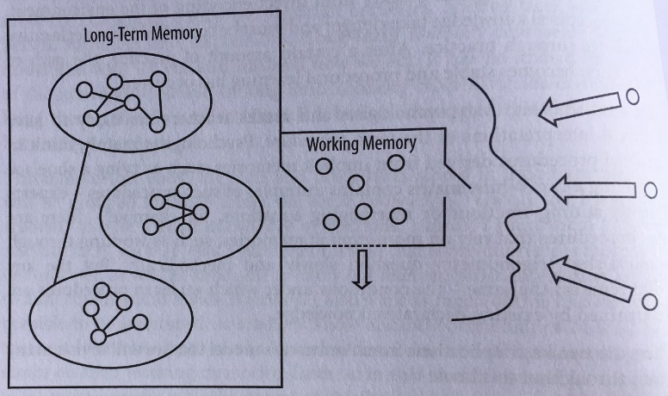
Direct teaching
Open tasks
Variation
Retention
Novice
Expert
Start of sequence
End of sequence

Slide 4
Pre-cursor knowledge
Visual representations
Common mistakes/difficulties
$$\frac{2}{3}of =14$$
$$\frac{3}{4} + \frac{5}{8}$$

Slide 5
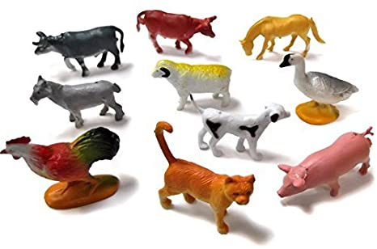
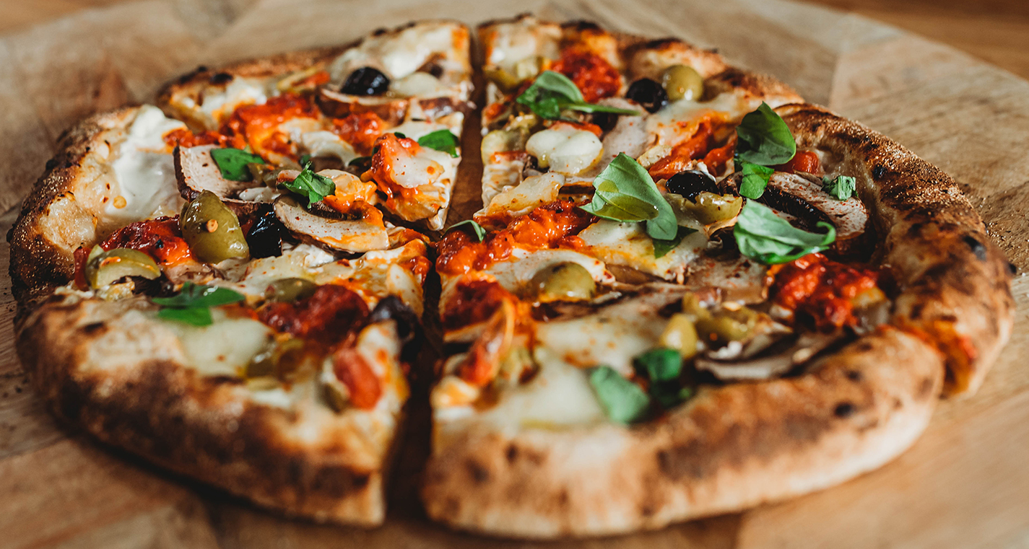
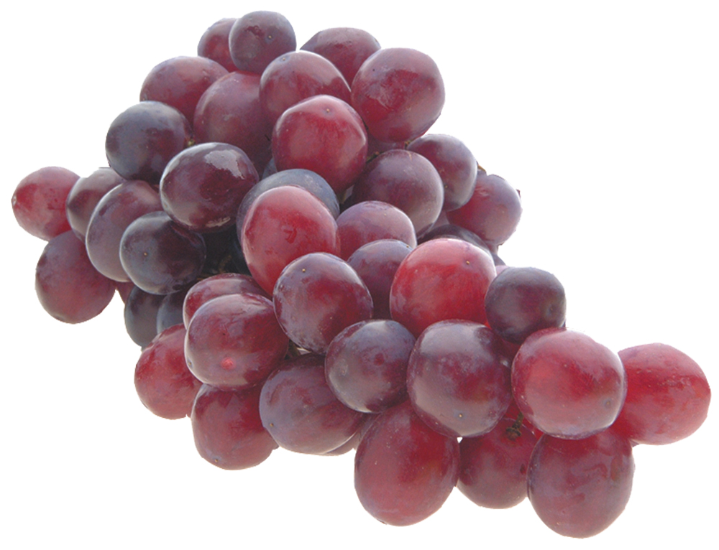
Do we need fractions?
3 pizzas shared between 6 children.
10 toys shared between 4 children.
4 children share 21 grapes.
4 children share 3 pieces of toast.
WHY FRACTIONS?
I SEE MATHS

Slide 6
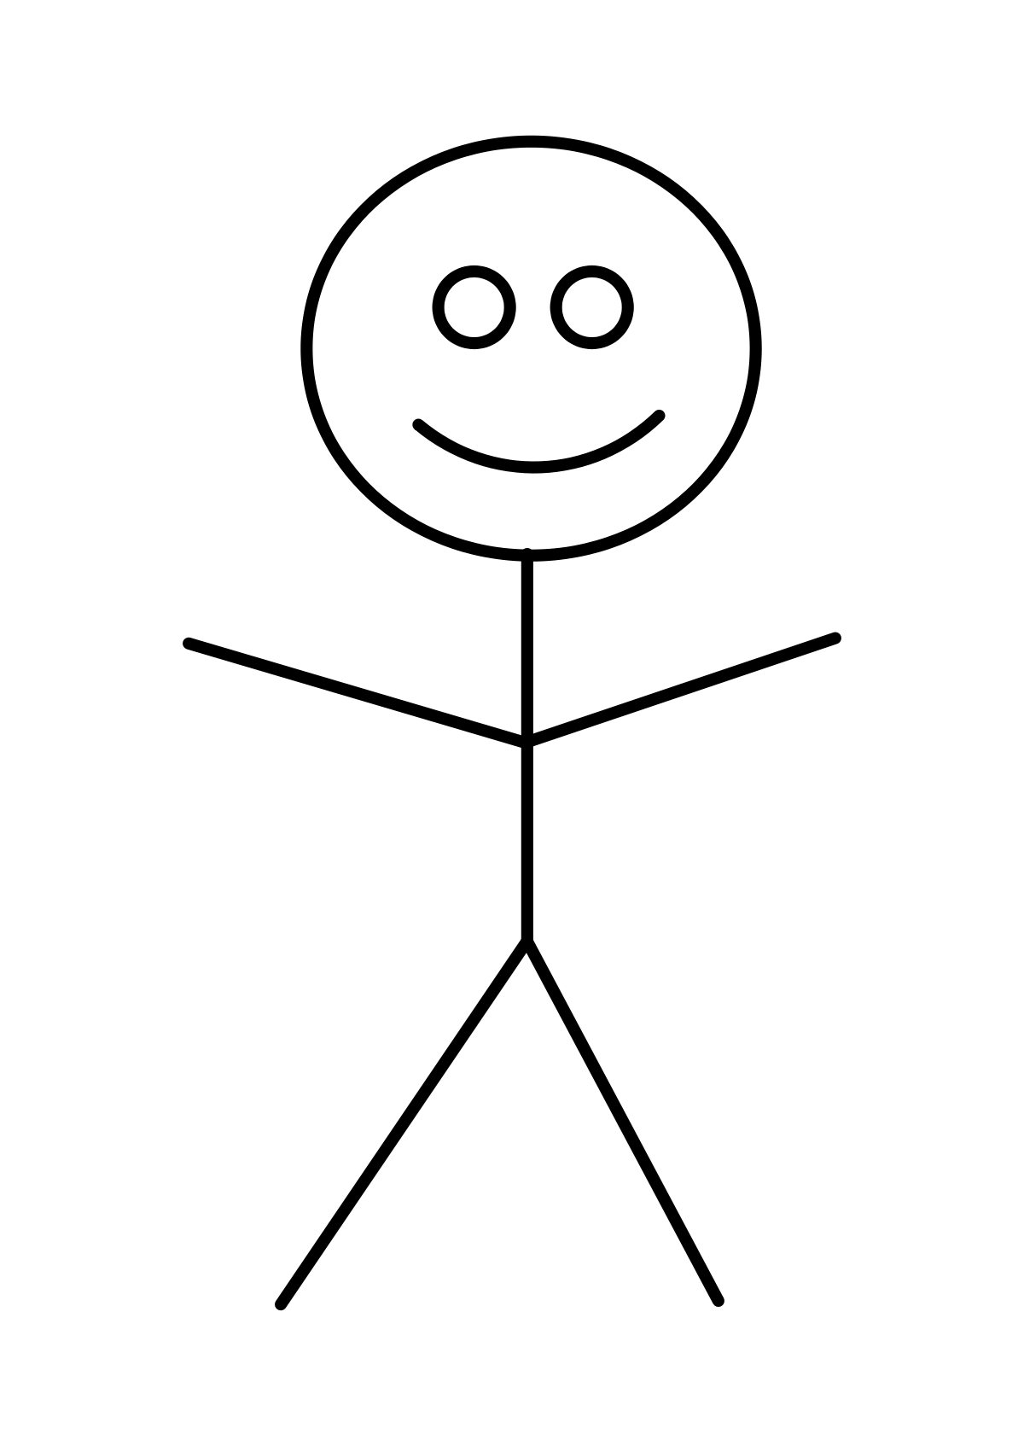

Slide 10
4 children are about to share some pizzas.
Then Harry joins them. He brings another pizza to share.
Now that Harry has come, will each child have more, less or the same amount of pizza?

Slide 11
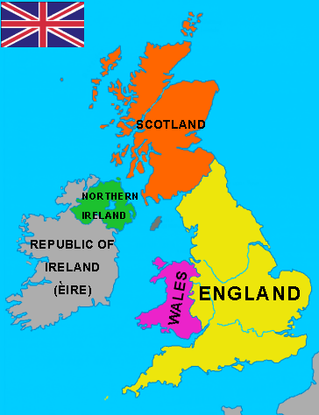
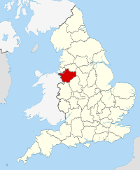
England as a part
England as the whole

Slide 12
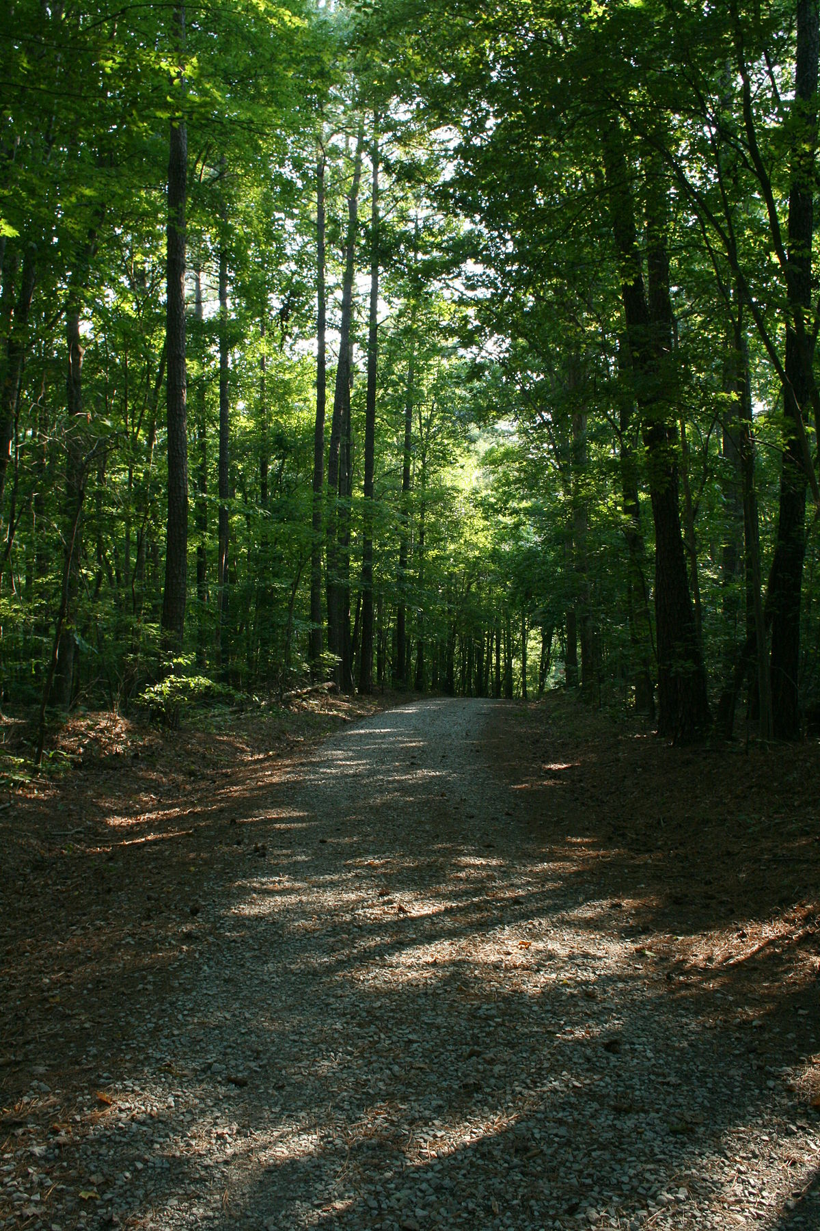
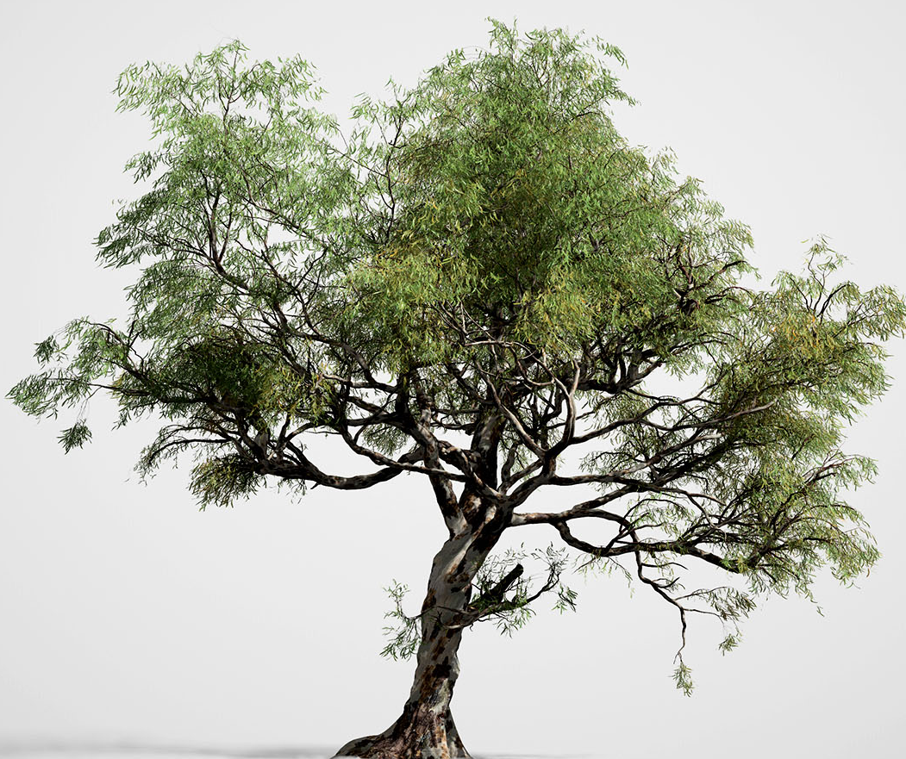
A tree as a part
A tree as the whole

Slide 13
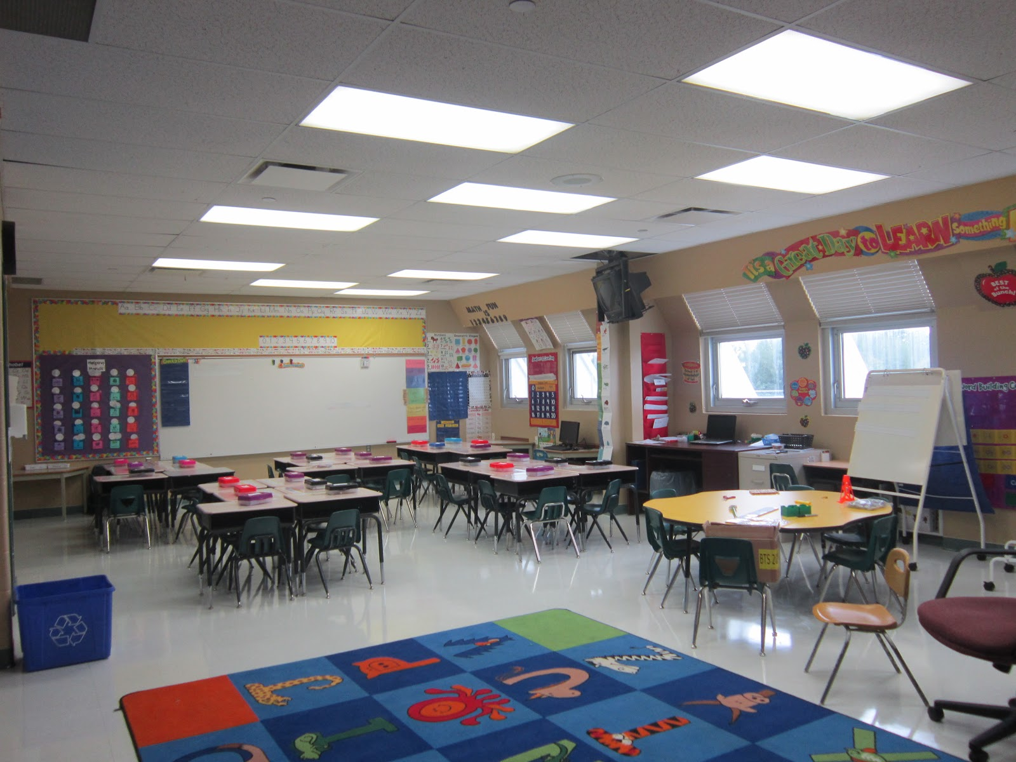
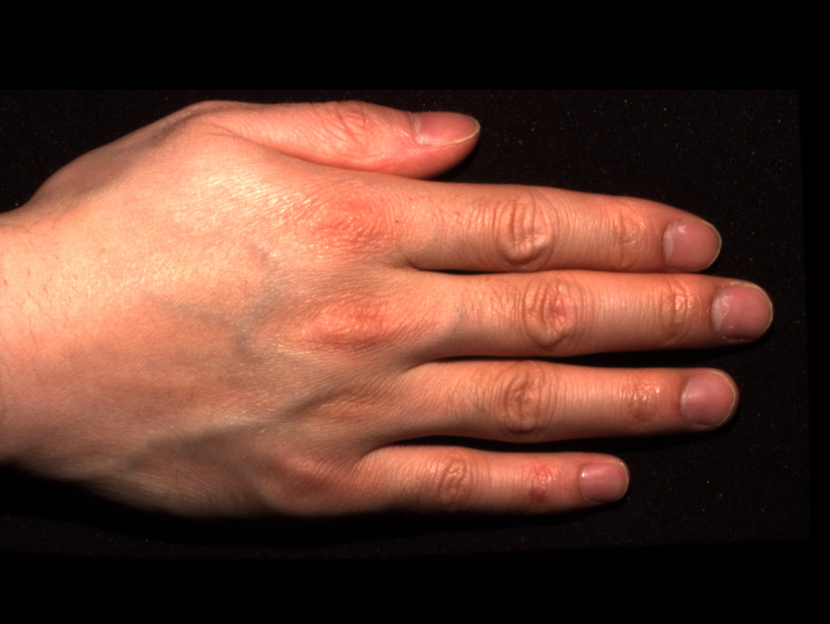
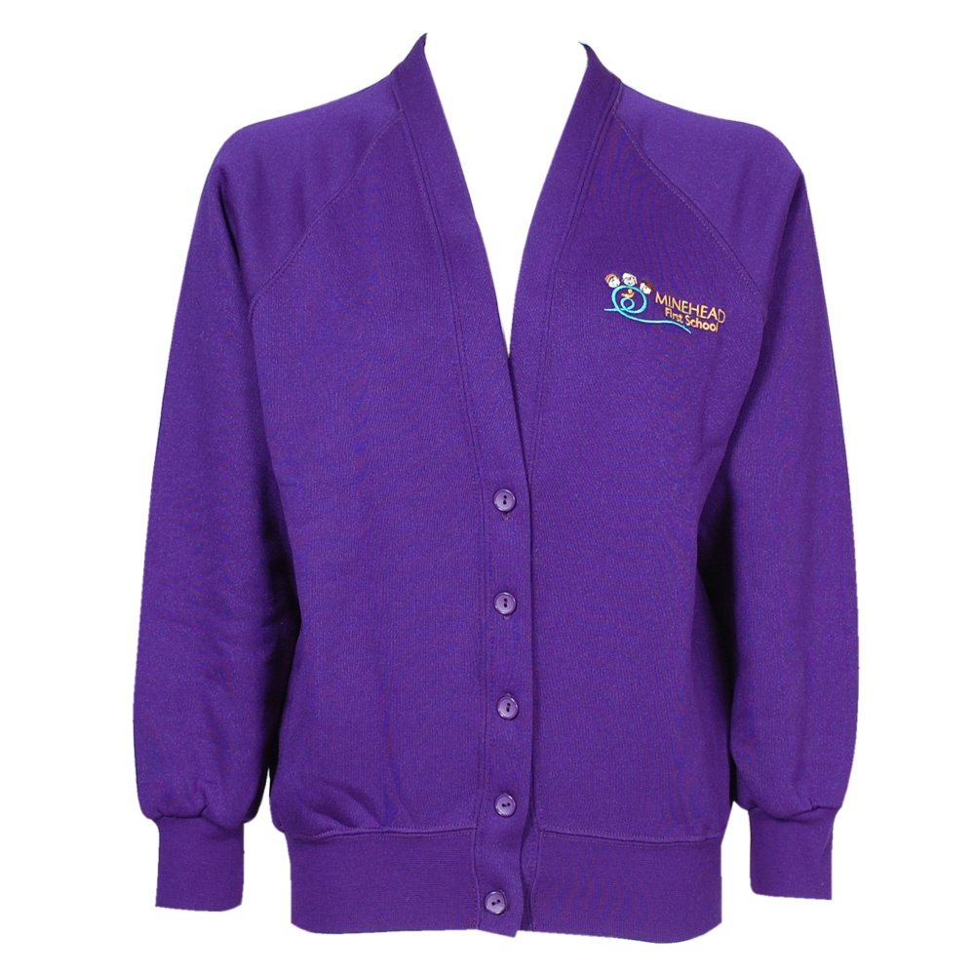
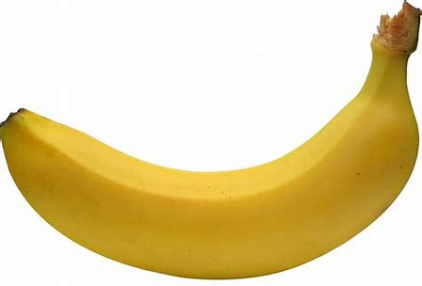
hand
classroom
banana
cardigan

Slide 15
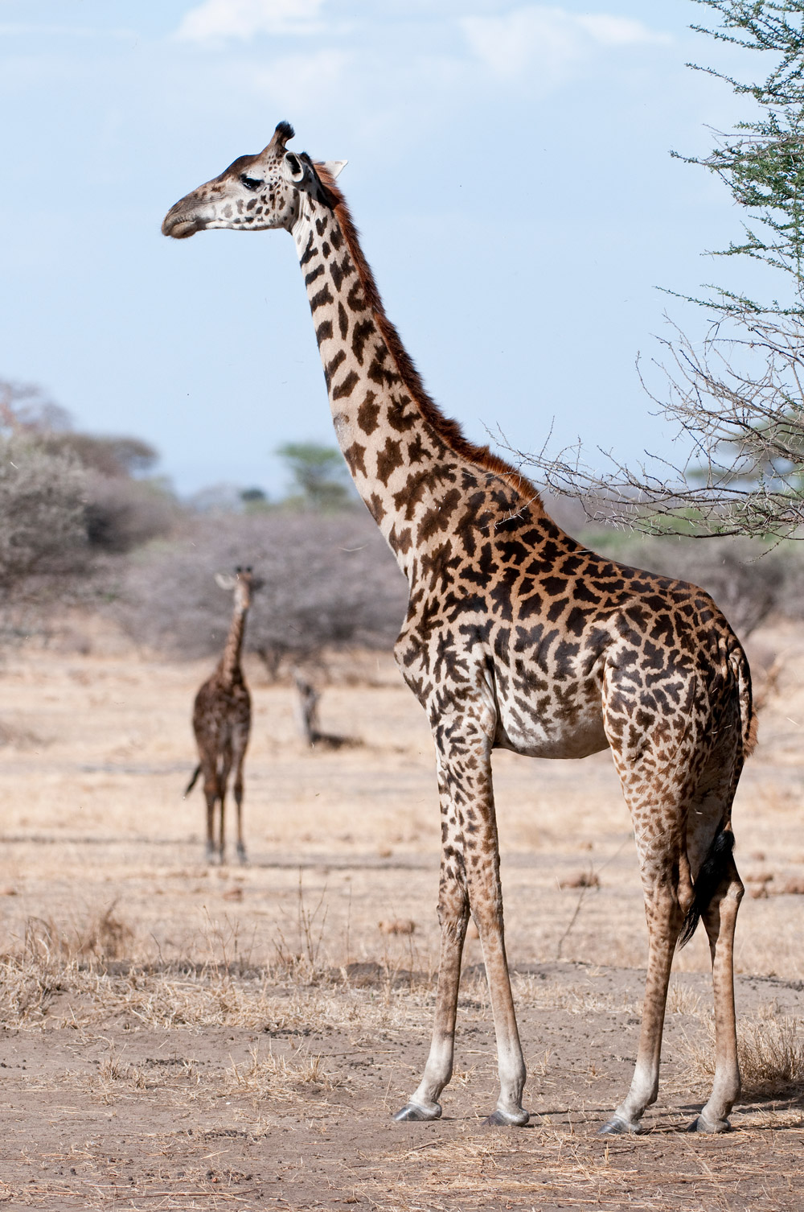
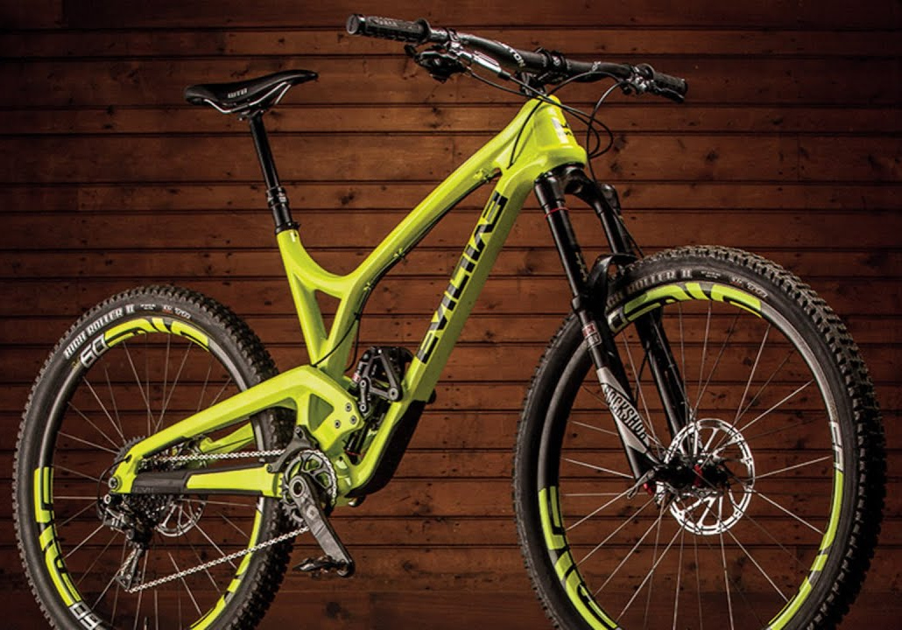
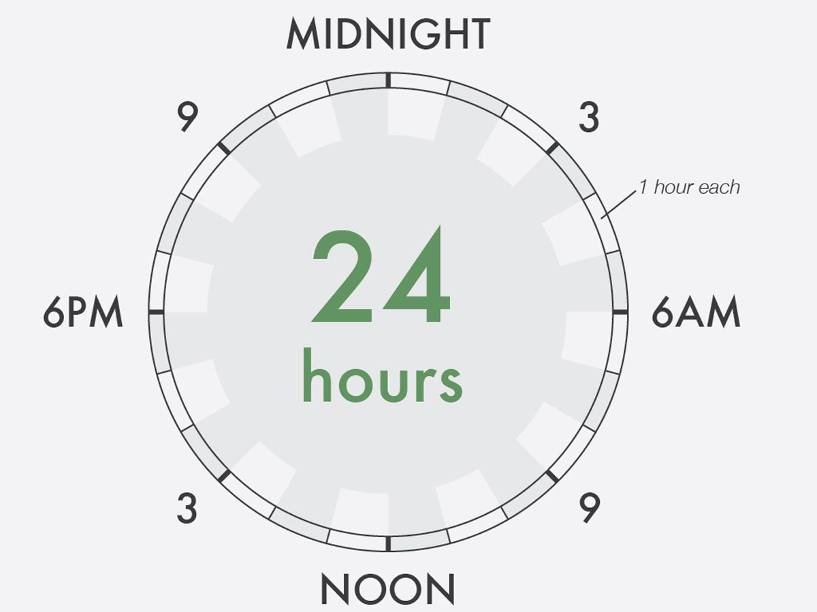
Compare the Fractions
The neck as a fraction of a giraffe.
The frame as a fraction of a bike.
A morning as a fraction of a day.
COMPARING PARTS
I SEE MATHS

Slide 16
Order the Fractions
RECAP
I SEE MATHS

Slide 18
FRACTIONS OF SHAPES
I SEE MATHS

Slide 19
FRACTIONS OF SHAPES
I SEE MATHS

Slide 20
FRACTIONS OF SHAPES
I SEE MATHS

Slide 21
FRACTIONS OF SHAPES
I SEE MATHS

Slide 22
$\frac{2}{4}$ or $\frac{2}{6}$
FRACTIONS OF SHAPES
I SEE MATHS

Slide 23
$\frac{2}{5}$ or $\frac{2}{6}$
FRACTIONS OF SHAPES
I SEE MATHS

Slide 24
FRACTIONS OF SHAPES
I SEE MATHS

Slide 25
FRACTIONS OF SHAPES
I SEE MATHS

Slide 26
FRACTIONS OF SHAPES
I SEE MATHS

Slide 27
Estimate or Exact Fraction?
COMPARING PARTS
I SEE MATHS

Slide 35
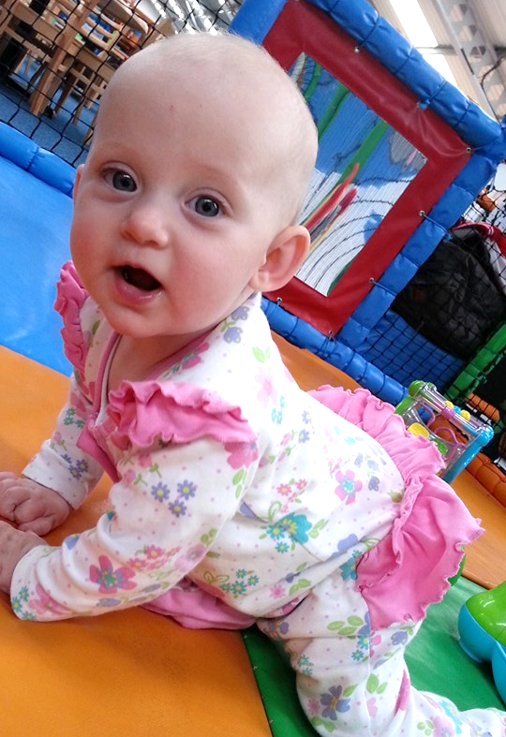
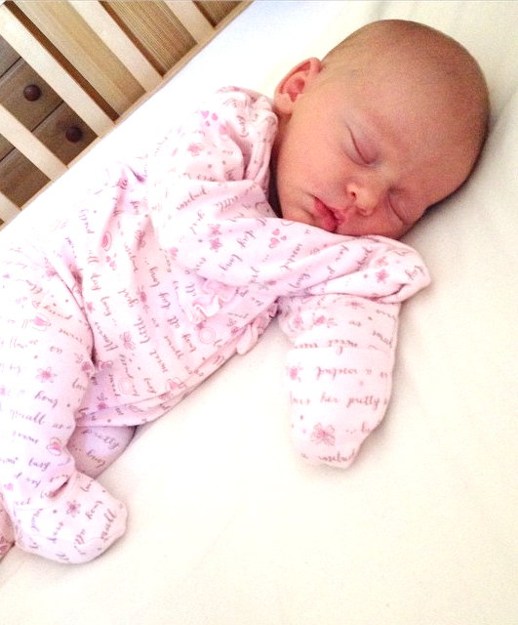
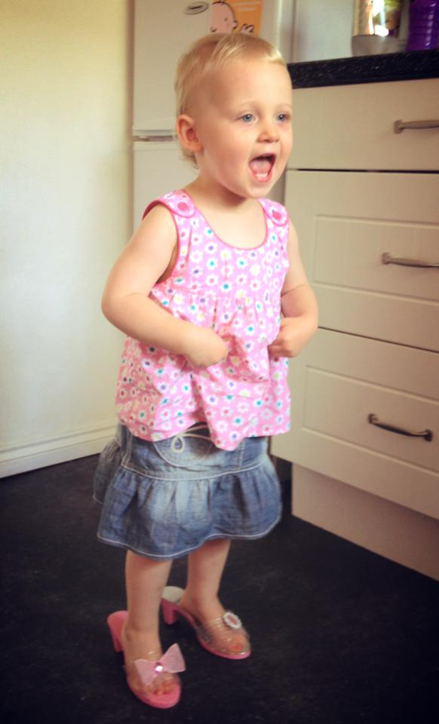
0
$$\frac{1}{4}$$
$$\frac{1}{2}$$
$$\frac{3}{4}$$
1
$$1\frac{1}{4}$$
$$1\frac{1}{2}$$
$$1\frac{3}{4}$$
2
$$2\frac{1}{4}$$
LINE UP, FRACTIONS!
I SEE MATHS

Slide 36
$$\frac{1}{6}$$ | $$\frac{1}{6}$$ | $$\frac{1}{6}$$ | $$\frac{1}{6}$$ | $$\frac{1}{6}$$ | $$\frac{1}{6}$$
0
$$\frac{1}{6}$$
$$\frac{2}{6}$$
$$\frac{3}{6}$$
$$\frac{4}{6}$$
$$\frac{5}{6}$$
1
$$\frac{1}{3}$$ | $$\frac{1}{3}$$ | $$\frac{1}{3}$$
0
$$\frac{1}{3}$$
$$\frac{2}{3}$$
1
$$\frac{1}{4}$$ | $$\frac{1}{4}$$ | $$\frac{1}{4}$$ | $$\frac{1}{4}$$
0
$$\frac{1}{4}$$
$$\frac{2}{4}$$
$$\frac{3}{4}$$
1
LINE UP, FRACTIONS!
I SEE MATHS

Slide 38
Estimate the Fraction
LINE UP, FRACTIONS!
I SEE MATHS

Slide 39
0
$$\frac{1}{4}$$
$$\frac{3}{4}$$
1
$$\frac{1}{2}$$
0
0.1
0.2
0.3
0.4
0.5
0.6
0.7
0.8
0.9
1
0
$$\frac{1}{5}$$
$$\frac{2}{5}$$
$$\frac{3}{5}$$
$$\frac{4}{5}$$
1
LINE UP, FRACTIONS!
I SEE MATHS

Slide 44
$\frac{1}{3}$ of 12
MAKE 32
I SEE MATHS

Slide 45
$\frac{1}{3}$ of 12
MAKE 32
I SEE MATHS

Slide 46
20
$\frac{1}{4}$ of 20 = 5
5
5
5
5
MAKE 32
I SEE MATHS

Slide 47
20
$\frac{3}{4}$ of 20 = 15
5
5
5
5
MAKE 32
I SEE MATHS

Slide 48
MAKE 32
I SEE MATHS

Slide 51
60
$\frac{1}{4}$ of 60 = 15
15
15
15
15
MAKE 32
I SEE MATHS

Slide 52
60
$\frac{1}{4}$ of 60 = 15
15
15
15
15
MAKE 32
I SEE MATHS

Slide 53
60
$\frac{1}{4}$ of 60 = 15
15
15
15
15
MAKE 32
I SEE MATHS

Slide 54
21
$\frac{2}{3}$ of 21 = 14
7
7
7
MAKE 32
I SEE MATHS

Slide 55
21
$\frac{2}{3}$ of 21 = 14
7
7
7
MAKE 32
I SEE MATHS

Slide 56
21
$\frac{2}{3}$ of 21 = 14
7
7
7
MAKE 32
I SEE MATHS

Slide 58
MAKE 32
I SEE MATHS

Slide 59
MORE THAN 1
I SEE MATHS

Slide 60
BETWEEN 2 AND 3
I SEE MATHS

Slide 61
Direct teaching
Open tasks
Variation
Retention
Novice
Expert
Start of sequence
End of sequence

Slide 66
Recap Q & A
Sequences of lessons
Different forms of number and representations
Reasoning techniques
Improving retention in long-term memory

