Slide 1
Reasoning in KS2 Maths 2
Chat, ‘All panellists’: only I will see
Chat, ‘All panellists and attendees’: we all see
Where you teach
Session 1 takeaway
How do I build reasoning into…

Slide 2
Variation
50% of 40 =
10% of 40 =
40% of 40 =
40% of 80 =
80% of 40 =
12 × 10 =
12 × 5 =
14 × 5 =
7 × 10 =
500 – 200 =
503 – 200 =
503 – 198 =
502 – 197 =

Slide 5
The big toy car is four times as long as the small toy car.

Slide 6
The big toy car is four times as long as the small toy car.

Slide 9
I know… so…
6 × 5 = 30
6 × 5 = 30
9 × 5 =

Slide 10
I know… so…
6 × 5 = 30
6 × 5 = 30
9 × 5 = 45

Slide 11
I know… so…
6 × 5 = 30
6 × 5 = 30
6 × 7 =

Slide 12
I know… so…
6 × 5 = 30
6 × 5 = 30
6 × 7 = 42

Slide 14
MULTIPLICATION: DIFFERENT WAYS
I SEE MATHS

Slide 15
MULTIPLICATION: DIFFERENT WAYS
I SEE MATHS

Slide 16
9 × 6 = 54
MULTIPLICATION: DIFFERENT WAYS
I SEE MATHS

Slide 17
9 × 6 = 54
MULTIPLICATION: DIFFERENT WAYS
I SEE MATHS

Slide 18
5 × 6 = 30
4 × 6 = 24
9 × 6 = 54
MULTIPLICATION: DIFFERENT WAYS
I SEE MATHS

Slide 19
9 × 6 = 54
MULTIPLICATION: DIFFERENT WAYS
I SEE MATHS

Slide 20
9 × 6 = 54
9 × 3 = 27
9 × 3 = 27
MULTIPLICATION: DIFFERENT WAYS
I SEE MATHS

Slide 21
9 × 6 = 54
MULTIPLICATION: DIFFERENT WAYS
I SEE MATHS

Slide 22
3 × 6 = 18
3 × 6 = 18
3 × 6 = 18
9 × 6 = 54
MULTIPLICATION: DIFFERENT WAYS
I SEE MATHS

Slide 23
14 × 6 = 84
MULTIPLICATION: DIFFERENT WAYS
I SEE MATHS

Slide 24
14 × 6 = 84
10 × 6 = 60
4 × 6 = 24
MULTIPLICATION: DIFFERENT WAYS
I SEE MATHS

Slide 25
14 × 6 = 84
7 × 6 = 42
7 × 6 = 42
MULTIPLICATION: DIFFERENT WAYS
I SEE MATHS

Slide 26
14 × 6 = 84
14 × 3 = 42
14 × 3 = 42
MULTIPLICATION: DIFFERENT WAYS
I SEE MATHS

Slide 33
8 × 3
MULTIPLICATION: WHICH WAY?
I SEE MATHS

Slide 34
8 × 3
MULTIPLICATION: WHICH WAY?
I SEE MATHS

Slide 35
4 × 6
MULTIPLICATION: WHICH WAY?
I SEE MATHS

Slide 36
5 × 6 = 30
10 × 3 = 30
MULTIPLICATION: WHICH WAY?
I SEE MATHS

Slide 37
5 × 6 = 30
10 × 3 = 30
3.5 × 18 = 63
63
MULTIPLICATION: WHICH WAY?
I SEE MATHS

Slide 38
5 × 6 = 30
10 × 3 = 30
3.5 × 18 = 63
7 × 9 = 63
MULTIPLICATION: WHICH WAY?
I SEE MATHS

Slide 39
5 × 6 = 30
10 × 3 = 30
3.5 × 18 = 63
7 × 9 = 63
MULTIPLICATION: WHICH WAY?
I SEE MATHS

Slide 41
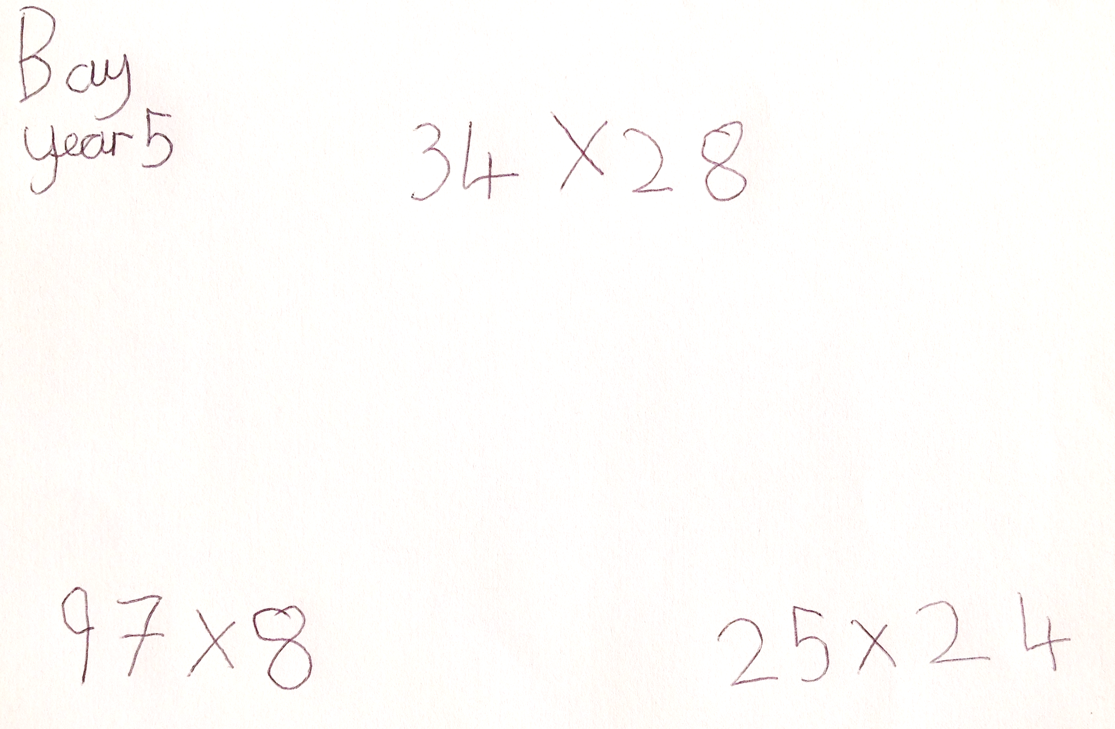
Rank by Difficulty
RECAP
I SEE MATHS

Slide 46
Explain the Mistake
With 20 matchsticks you can make 5 triangles. 5 matchsticks are left over.
MATCHSTICK MAKERS
I SEE MATHS

Slide 47
Explain the Mistake
With 20 matchsticks you can make 5 triangles. 5 matchsticks are left over.
MATCHSTICK MAKERS
I SEE MATHS

Slide 48
With matchsticks I can make hexagons and 4 matchsticks are left over.
RECAP
I SEE MATHS

Slide 50
80 ÷ 10
80 ÷ 4
80 ÷ 20

Slide 51
480 people go to a football match.
4 people go in each car.
How many cars are needed?
15 children share 60 grapes.
How many grapes each?

Slide 52
Which can we work out with no calculation?
Single-digit factors of 90
1 2 3 4 5 6 7 8 9
FINDING FACTORS PART 2
I SEE MATHS

Slide 53
Rank by Difficulty
18 ÷ 4
12 ÷ 4
52 ÷ 4
40 ÷ 4

Slide 54
Split numbers to divide
52 ÷ 4
52
4
4
4
4
4
4
4
4
4
4
4
4
4

Slide 55
Split numbers to divide
52 ÷ 4
52
4
4
4
4
4
4
4
4
4
4
4
4
4
40
12
4
4
4
4
4
4
4
4
4
4
4
4
4

Slide 56
Split numbers to divide
45 ÷ 3
70 ÷ 5

Slide 64
Rank by Difficulty
200 ÷ 24
120 ÷ 24
2424 ÷ 24
500 ÷ 24

Slide 72
Recap Q & A
Sequences of lessons
Equipment/images to build abstract thinking
Variation
Other maths curriculum areas

