Slide 1
Early Number Sense
Chat, ‘All panellists’: only I will see
Chat, ‘All panellists and attendees’: we all see
Where you teach
I’d like to help a child who…
I’d like ideas for… We have introduced…

Slide 3
1 | 2 | 3 | 4 | 5 | 6 | 7 | 8 | 9 | 10
11 | 12 | 13 | 14 | 15 | 16 | 17 | 18 | 19 | 20
5 + 3
count in steps of 2 to 20

Slide 4
a | b | c | d | e | f | g | h | i | ao
aa | ab | ac | ad | ae | af | ag | ah | ai | bo
5 + 3
count in steps of 2 to 20

Slide 5
a | b | c | d | e | f | g | h | i | ao
aa | ab | ac | ad | ae | af | ag | ah | ai | bo
e + c
count in steps of b to bo

Slide 7
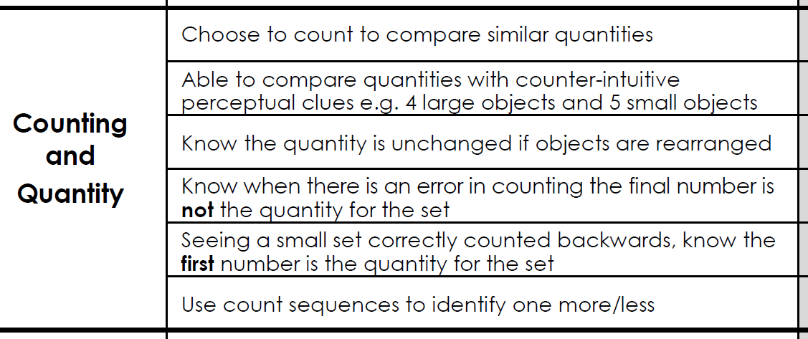

Slide 8
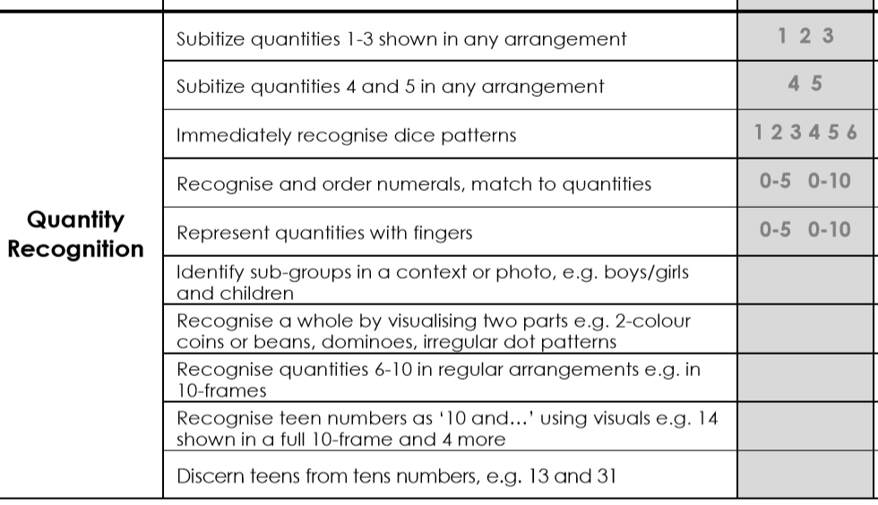

Slide 9
Number as length
10
9
8
7
6
5
4
3
2
1
0

Slide 10
Number as length
10
0

Slide 11
Number as length
10
5
0

Slide 13
Big Ideas of Mathematics: Additive Reasoning
Example A: Jen has 8 sweets. Kim has 5 sweets. How many more sweets does Jen have?
Example B: Tim is 8. His brother Sam is 5. How much older is Tim than Sam?
Example C: Kam had 8 grapes. He ate 5. How many does he have left?

Slide 14
Continue and make patterns
Spot and correct mistakes
Represent a pattern with other objects
Identify the ‘unit of repeat’

Slide 15
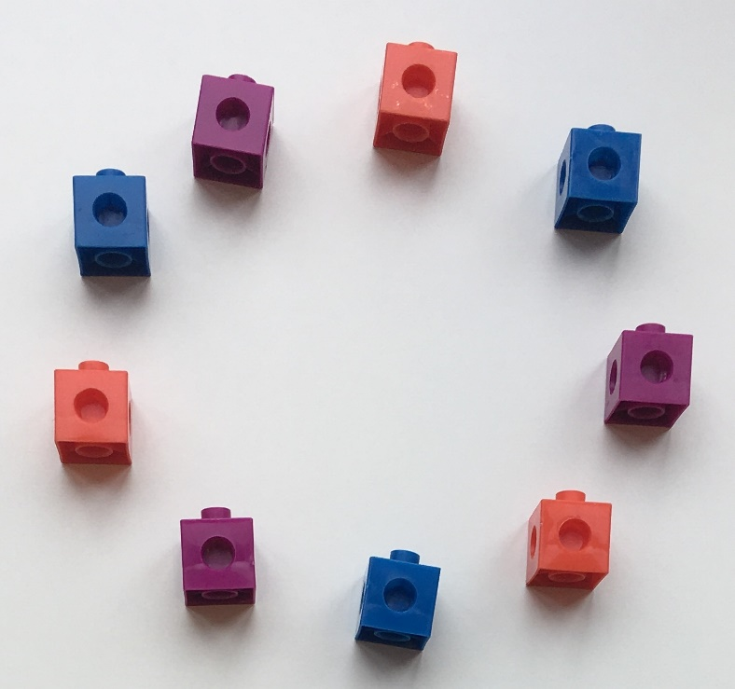
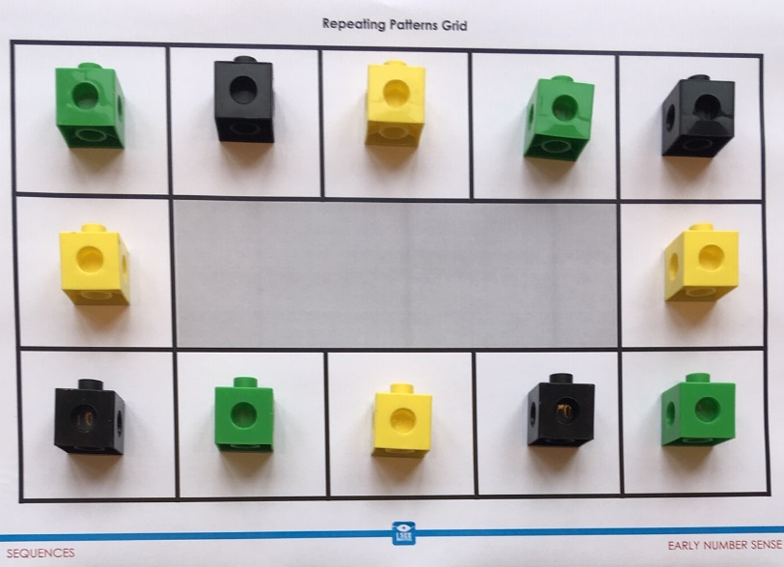
Circular patterns
Circular, fixed spaces

Slide 16
Make AB pattern
Represent AB pattern (e.g. draw)
Make and represent ABAB pattern

Slide 17
Extend ABAB pattern
Spot mistakes in repeating AB pattern
Break AB pattern into repeated units

Slide 18
Recap Q & A
Depth in quantity recognition and counting
Number Foundations Assessment
Visuals/resources, number as length
Deepening understanding of pattern

