Slide 1

You will see some dots very quickly.
Then they will be hidden.
Whisper to your partner:
How many dots?
There are 4 pictures.
10-FRAMES: QUANTITIES TO 7
EARLY NUMBER SENSE

Slide 2
10-FRAMES: QUANTITIES TO 7
EARLY NUMBER SENSE

Slide 3
You will see some dots very quickly.
Then they will be hidden.
Whisper to tell your partner:
How many dots?
There are 3 pictures.
10-FRAMES: QUANTITIES TO 7
EARLY NUMBER SENSE

Slide 4
10-FRAMES: QUANTITIES TO 7
EARLY NUMBER SENSE

Slide 5
You will see some dots very quickly.
Then they will be hidden.
Whisper to tell your partner:
How many dots?
There are 3 pictures.
10-FRAMES: QUANTITIES TO 7
EARLY NUMBER SENSE

Slide 6
10-FRAMES: QUANTITIES TO 7
EARLY NUMBER SENSE

Slide 7
You will see some dots very quickly.
Then they will be hidden.
Whisper to tell your partner:
How many dots?
There are 3 pictures.
10-FRAMES: QUANTITIES TO 7
EARLY NUMBER SENSE

Slide 8
10-FRAMES: QUANTITIES TO 7
EARLY NUMBER SENSE

Slide 9
You will see some dots very quickly.
Then they will be hidden.
Whisper to tell your partner:
How many dots?
There are 3 pictures.
10-FRAMES: QUANTITIES TO 7
EARLY NUMBER SENSE

Slide 10
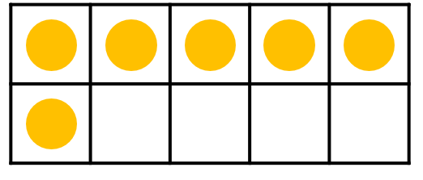
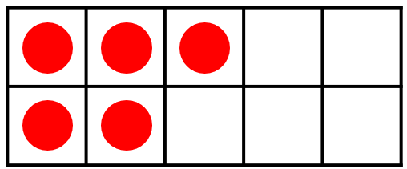
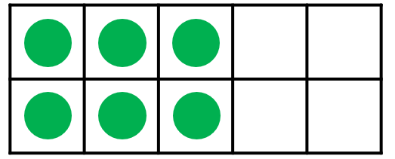
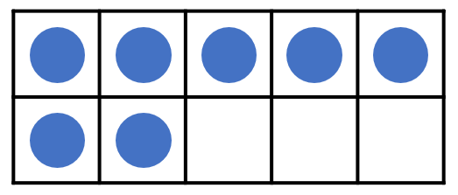
10-FRAMES: QUANTITIES TO 7
EARLY NUMBER SENSE

